Slide 1

Ending GBVF 100-Day Challenge
Leadership Briefing

Slide 2



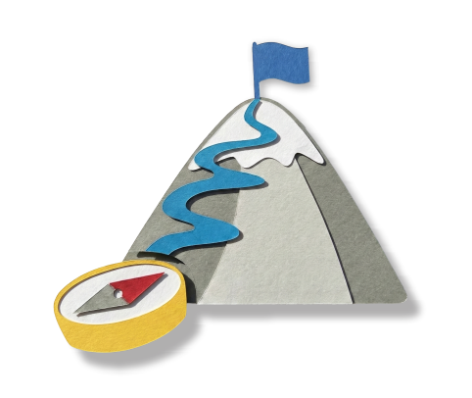

End GBVF Movement Context
What are 100-Day Challenges?
Discussion points
Focus of our 100-Day Challenge
100-Day Team Members

Slide 3








Localising the National Strategic Plan
1
Accountability,
Coordination and
Leadership
6
Research and
Information
Management
2
Prevention and Rebuilding Social Cohesion
5
Economic
Power
3
Justice,
Safety and
Protection
4
Response, Care, Support and Healing

Slide 4


Department of Social Development
Department of Women, Youth and Persons with Disability
Department of
HIgher Education and Training
End GBVF 100-Day
Challenge Conveners
Department
of Cooperative Governance and Traditional Affairs
Department of Monitoring and Evaluation (Office of the President)
South African Local Government Association (SALGA)
Department of Justice and Constitutional Development

Slide 5
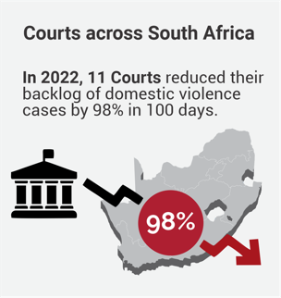
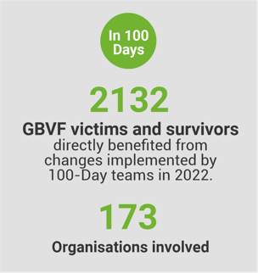
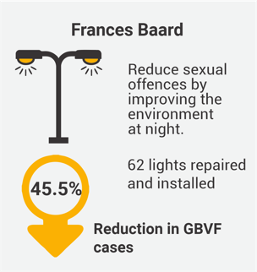
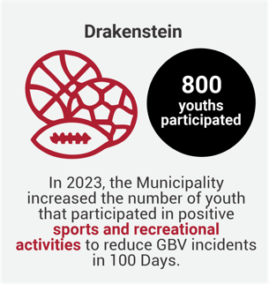
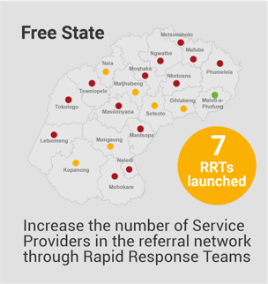
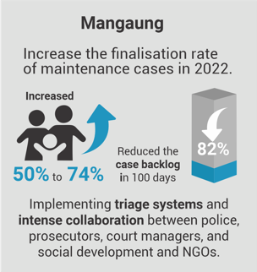
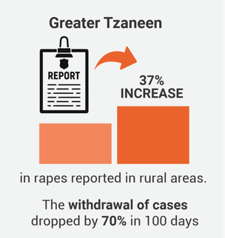
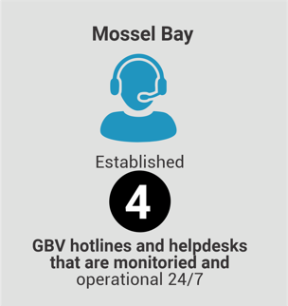
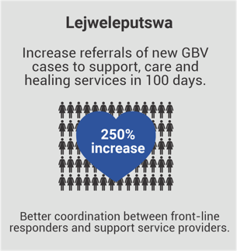

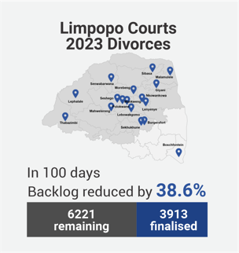
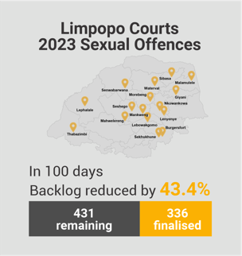
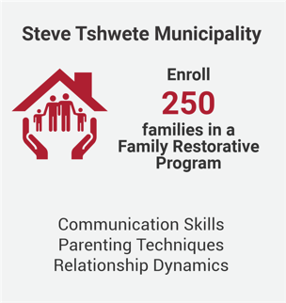
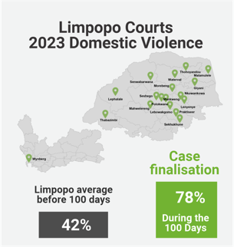
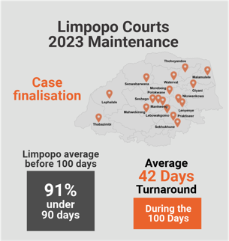
Some highlights from past Challenges

Slide 6

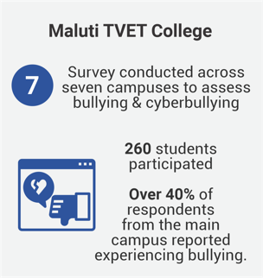

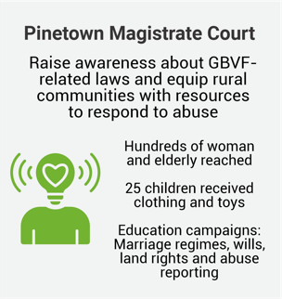
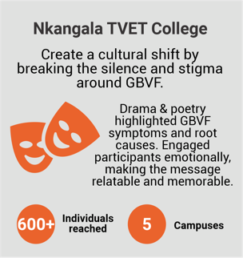
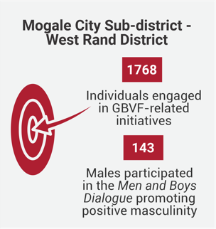

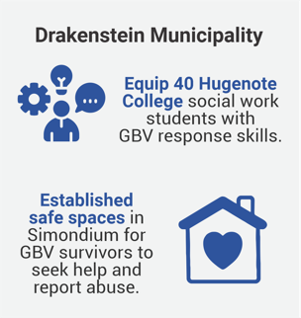
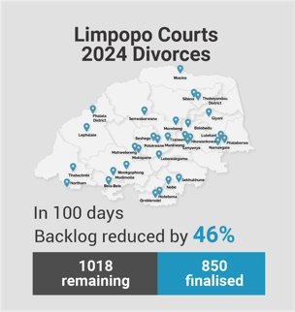
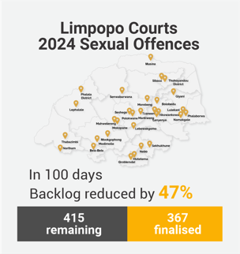
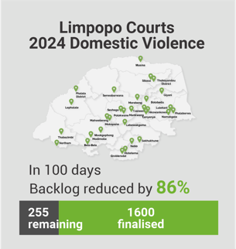
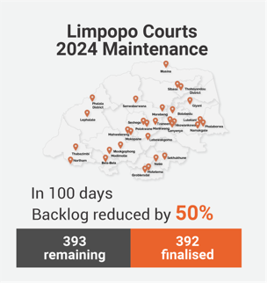
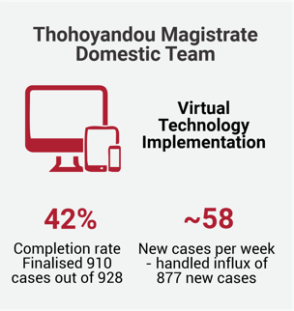
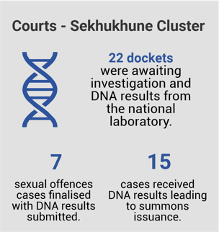
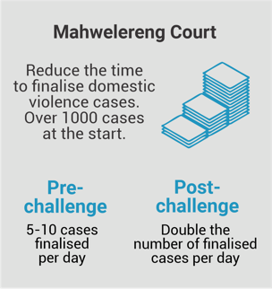
Some highlights from past Challenges

Slide 7
End GBVF Movement Context
What are 100-Day Challenges?
Discussion points
Focus of our 100-Day Challenge
100-Day Team Members

Slide 8









What is a 100-Day Challenge?
It is a project
It lasts 100 days
Like all projects, it has a…
A goal
A team
A plan
What makes it different?
It is designed to harness the power of crises, without creating a crisis!

Slide 9

What makes it different?

Slide 10




Crisis
100-Day Challenge
Sense of urgency
Fast - 100 days from project start to completion
Success, or even survival is far from guaranteed
100-Day Goal feels almost impossible to achieve
Inspire unusual behaviours
“All hands-on deck” - all focused on the crises
Right team is assembled, all committed to the goal
People ignore red tape, hierarchy and approvals
The Challenge team has full agency of their plan, to experiment and pivot during the 100 days

Slide 11





100-Day Challenge
Intense
collaboration
Fast - 100 days from project start to completion
100-Day Goal feels almost impossible to achieve
Inspires
Frequent
innovation
Right team is assembled, all committed to the goal
Disciplined implementation
100-day team has full agency of their plan, to experiment and pivot during the 100 days

Slide 12
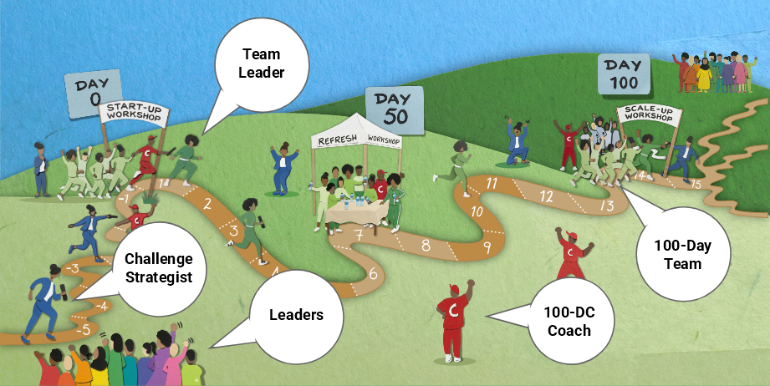
The 100-Day Relay Race

Slide 13
End GBVF Movement Context
What are 100-Day Challenges?
Discussion points
Focus of our 100-Day Challenge
100-Day Team Members

Slide 14

Municipalities
Prevention (Pillar 2)
In Schools: Reduce incidents of gender-related bullying in schools
In the Workplace: Reduce incidents of sexual harassment in offices (Pillars 5)
On the Street: Reduce the incidence of GBVF in "hot zones"
Social media: People sign-up committing to speak-up when someone witnesses a GBVF incident
Reduce incidents of GBVF in taxi’s or taverns
Support (Pillar 4)
Increase the number of support services that survivors of GBV actually receive
Increase number and utilisations of safe spaces/shelters
Reduce incidents of GBVF for survivors coming to and from courts or police stations
Economic Empowerment (Pillar 5)
Increase procurement from women-owned businesses, with a focus on survivors of GBVF
Transition survivors from basic skills-training into active employment or micro-enterprises

Slide 15

Education
TVET/University/Schools
Survivor Impact
Focus Area examples
Break the Silence (Pillar 2)
Increase number of students who safely report bullying or harassment
Increase number of bystanders (peers) conducting appropriate early warning interventions or safe reporting
Improve the safety of the environment to reduce the GBVF “hot zones”
Heal the Wounds (Pillar 4)
Increase number of survivors accessing counselling and support services.
Create or increase the number of safe spaces
Create Deterrence (Pillar 3)
Increase number of perpetrators facing disciplinary action

Slide 16

Justice
Survivor Impact
Focus Area examples
Access to Justice
Reduce rate of case withdrawals
Increase ﬁnalisation rate of (Maintenance or Divorce or Sexual oﬀence) case
Increase number of virtual hearings
Increase the online application for Domestic Violence protection orders
Speed
Reduce the backlog of (Domestic violence Protection orders or Maintenance or Divorce or Sexual oﬀence) cases
Reduce average time from filing to resolution
Reduce turnaround time for issuing and serving ﬁnalised Domestic Violence Interim Protection Orders
Service Quality and Client Experience
Improve victim friendly experience of court clients (model court).

Slide 17
End GBVF Movement Context
What are 100-Day Challenges?
Discussion points
Focus of our 100-Day Challenge
100-Day Team Members

Slide 18
100-Day Team Members
What to look for in team members
Involved or close to direct service delivery.
Interested in the topic and knowledgeable about it.
Team player – likes to collaborate with others.
Has expressed frustration about this issue in the past
Able to bring others along - respected by colleagues
Ready to ‘stretch their wings (developmental opportunity)
Offers new ideas - ready to take risks
The ideal team size is 8-12 individuals with diversity of perspectives and backgrounds.

Slide 19




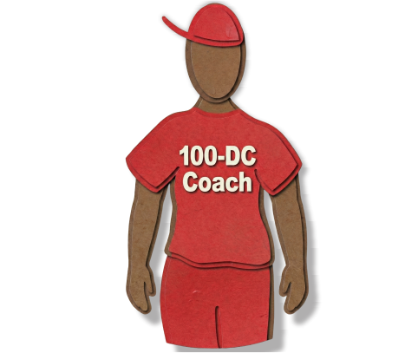

Countdown to Scale-up
Steps
to get
ready
Draft Challenge Note
to the team
Challenge Strategist
Challenge Strategist
Finalise team membership
Gather baseline
information on Focus area
Team
Coach
Send “hold the date” calendar
invitation to the Scale-up Workshop
Team Coach

Slide 20
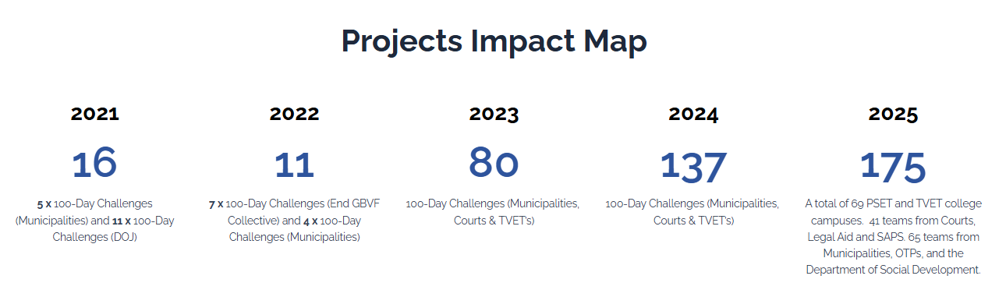

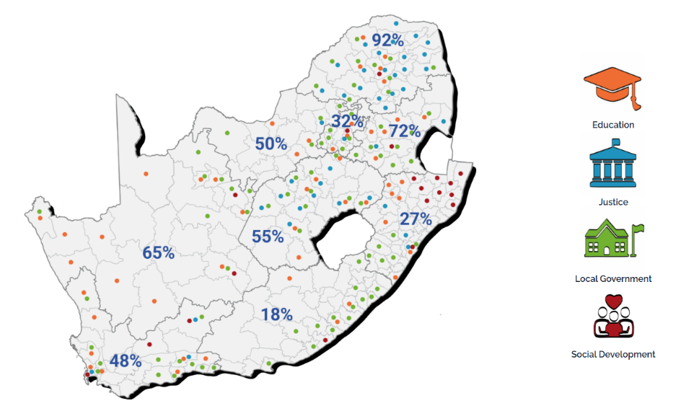

Other Movement tools
Go to the website.
All in one place.
www.endinggbvf.org

Slide 21


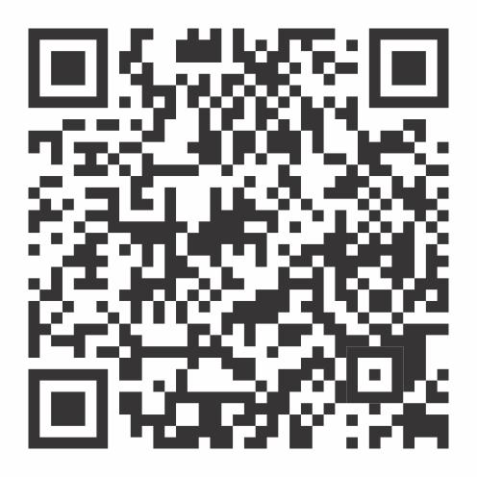
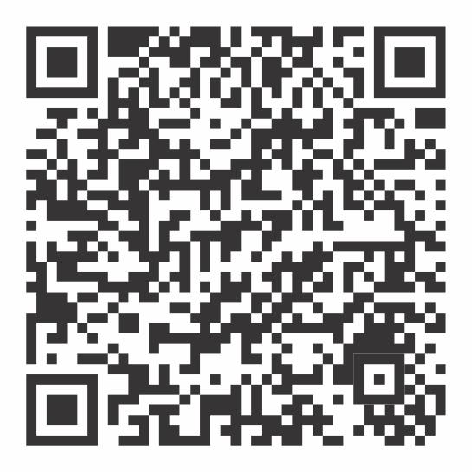


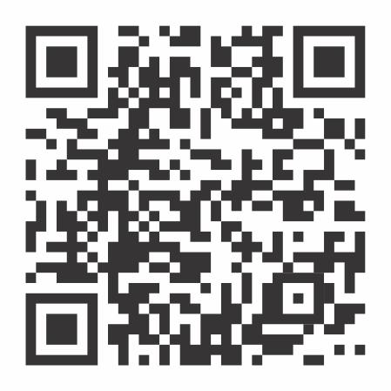
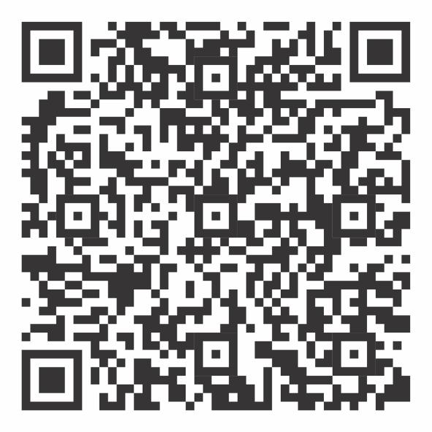
Other Movement tools
https://www.facebook.com/endgbvf100days
https://www.instagram.com/endgbvf_100daychallenges/
Follow your
team on
Social Media.
https://x.com/gbvf100days
https://www.linkedin.com/company/endgbvf-100-day-challenges

