Slide 1

Start-up Workshop

Slide 2





Understanding our 100-Day Challenge
Setting our 100-Day goal
Objectives
Shaping our Team Agreement
Developing our 100-Day Plan

Slide 3








Localising the National Strategic Plan
1
Accountability,
Coordination and
Leadership
6
Research and
Information
Management
2
Prevention and Rebuilding Social Cohesion
5
Economic
Power
3
Justice,
Safety and
Protection
4
Response, Care, Support and Healing

Slide 4

Focus of our 100-Day Challenge
Team coach note
Add the focus area to the slide. The focus area selected by the leaders and which is mentioned in the Challenge note.
This is the slide where the Challenge Strategist or a leader will give a brief overview of the selected focus area with the team.

Slide 5

Examples of previous 100-Day Challenges
Team coach note
In the next two slides, we provide examples of previous 100-Day Challenges results - You can choose some to share with your team.
Choose examples that relate to the team’s focus area. Delete those that are not relevant and make the remaining blocks bigger. Best to have 3-4 examples, not more.

Slide 6
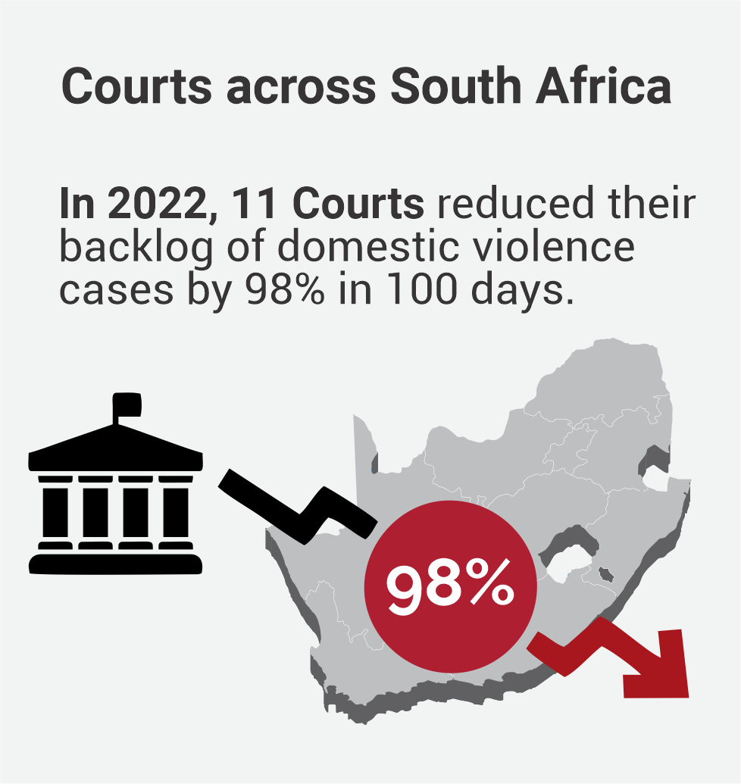
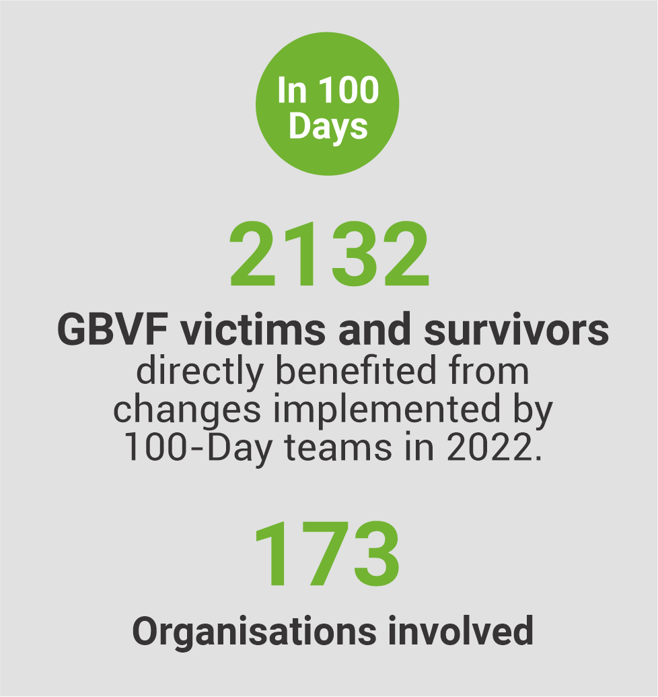
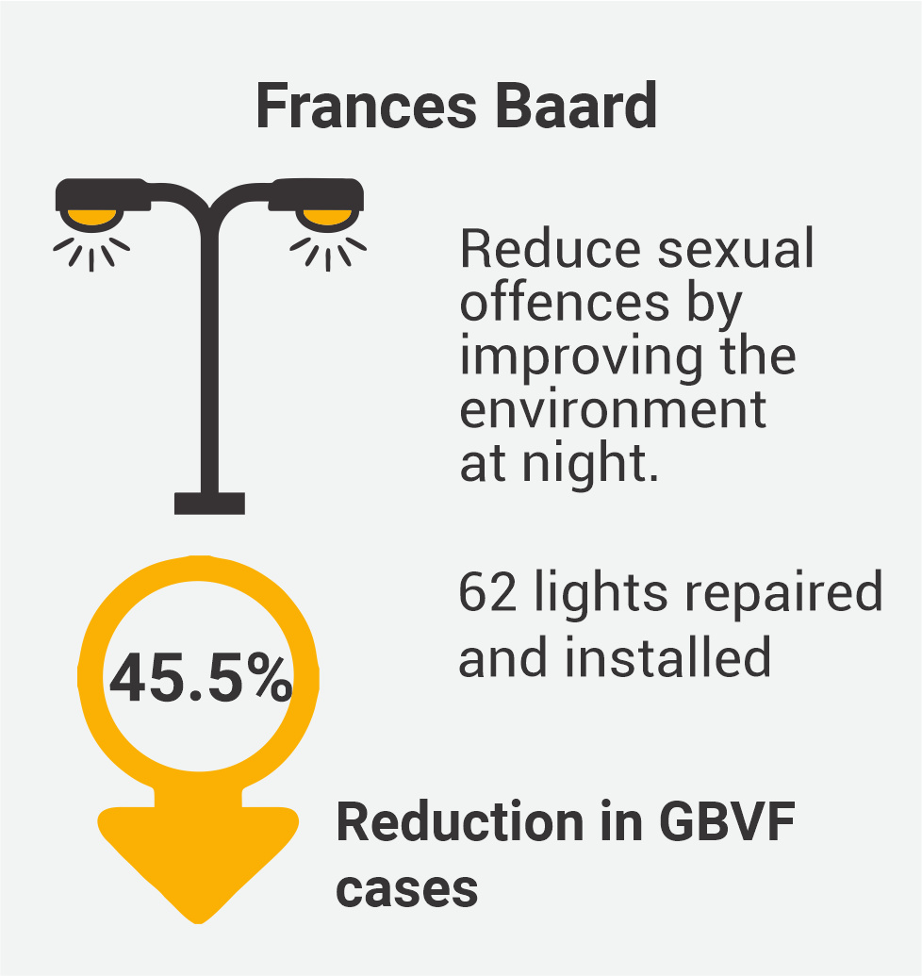
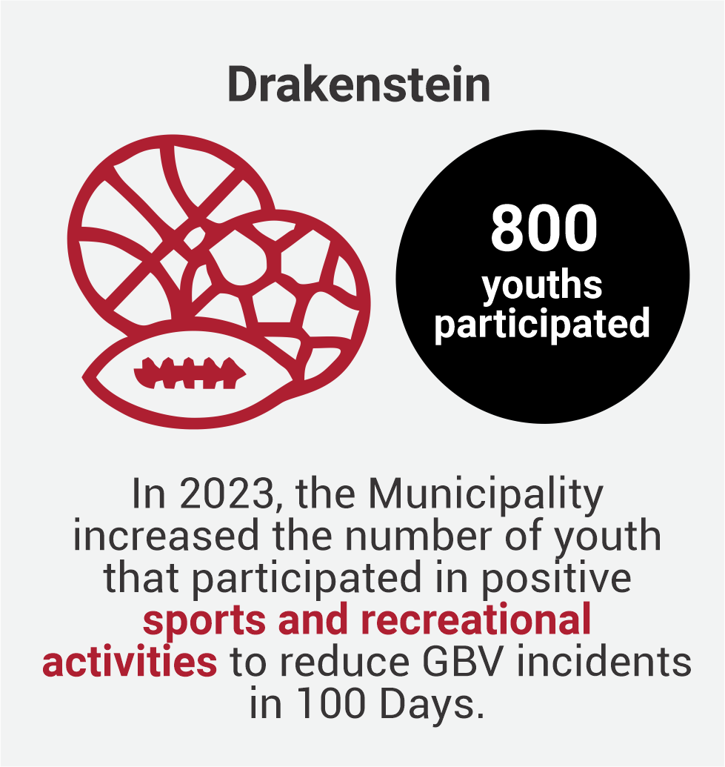
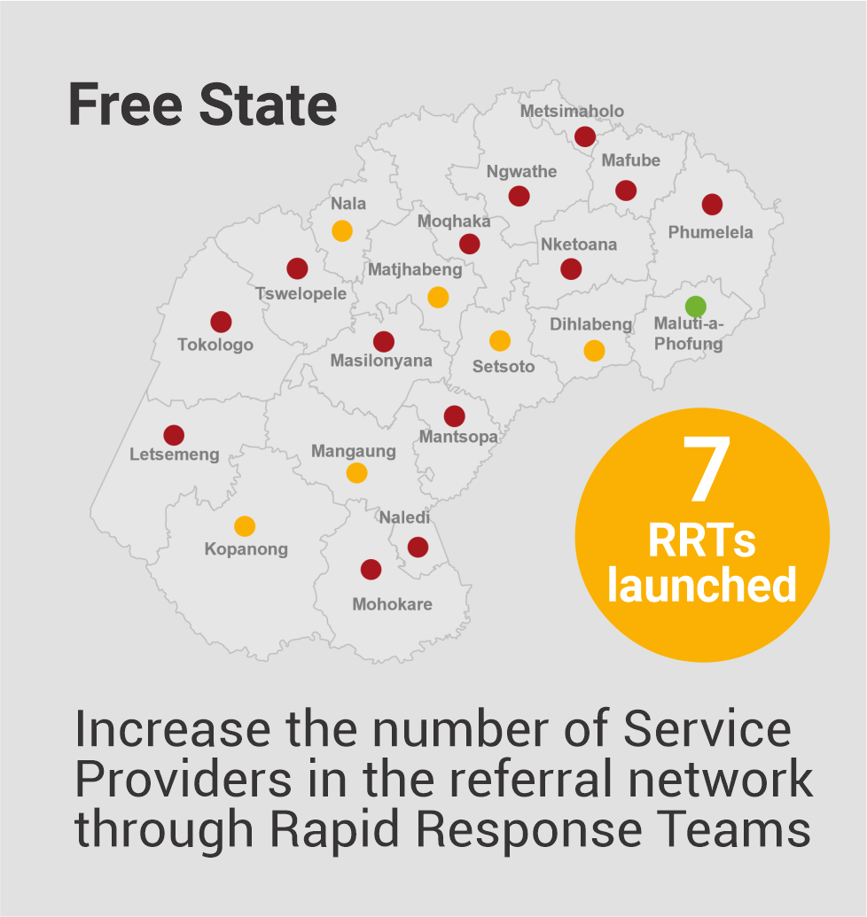
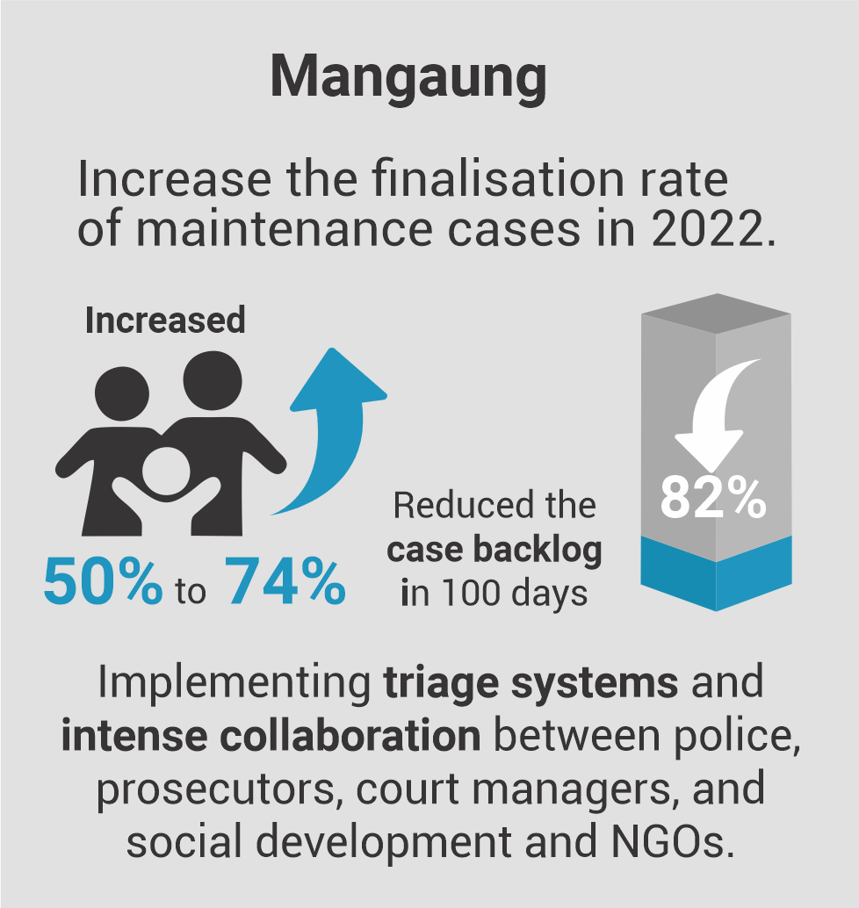
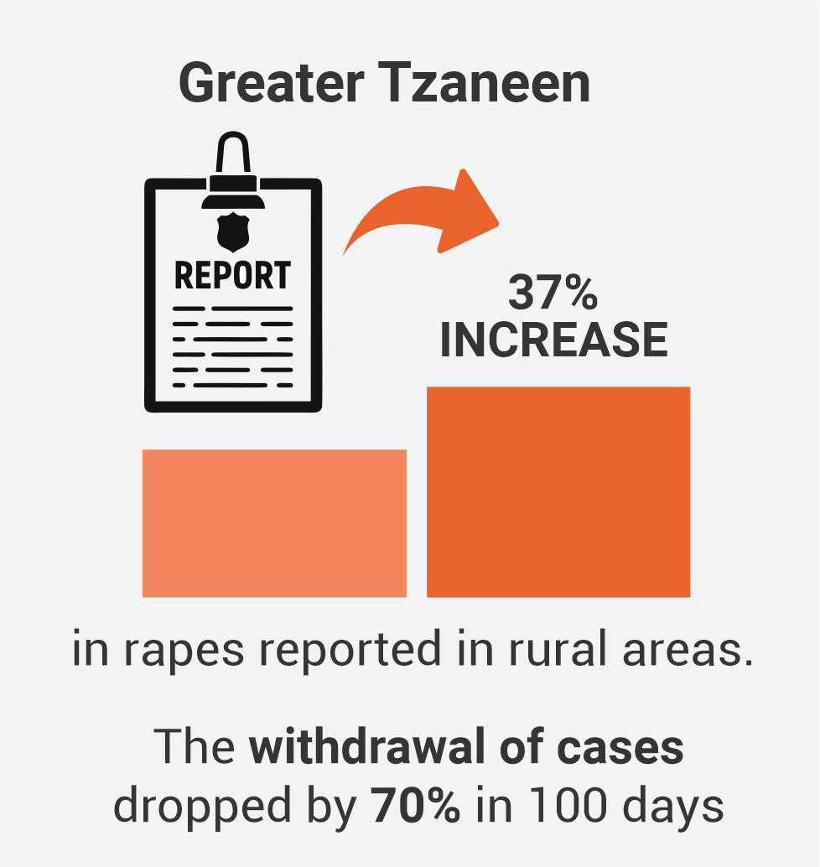
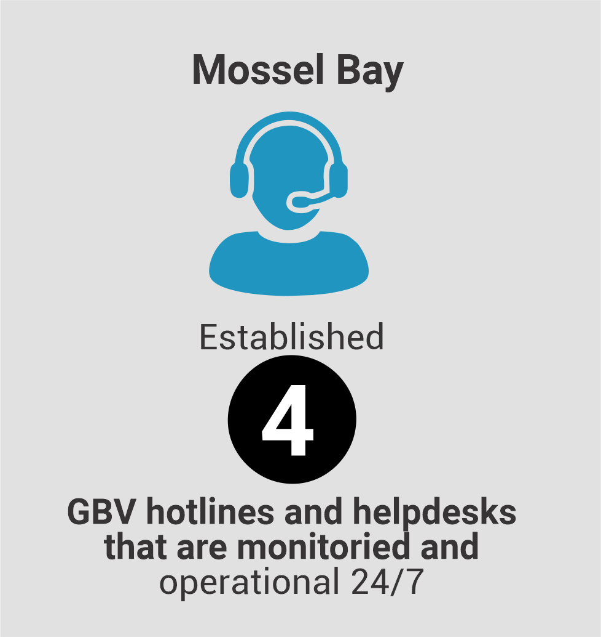
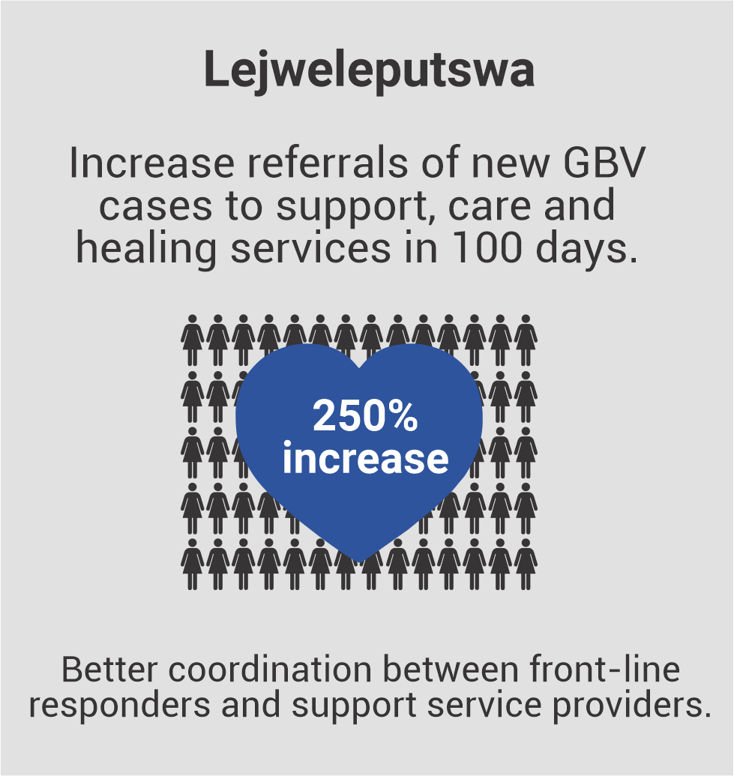

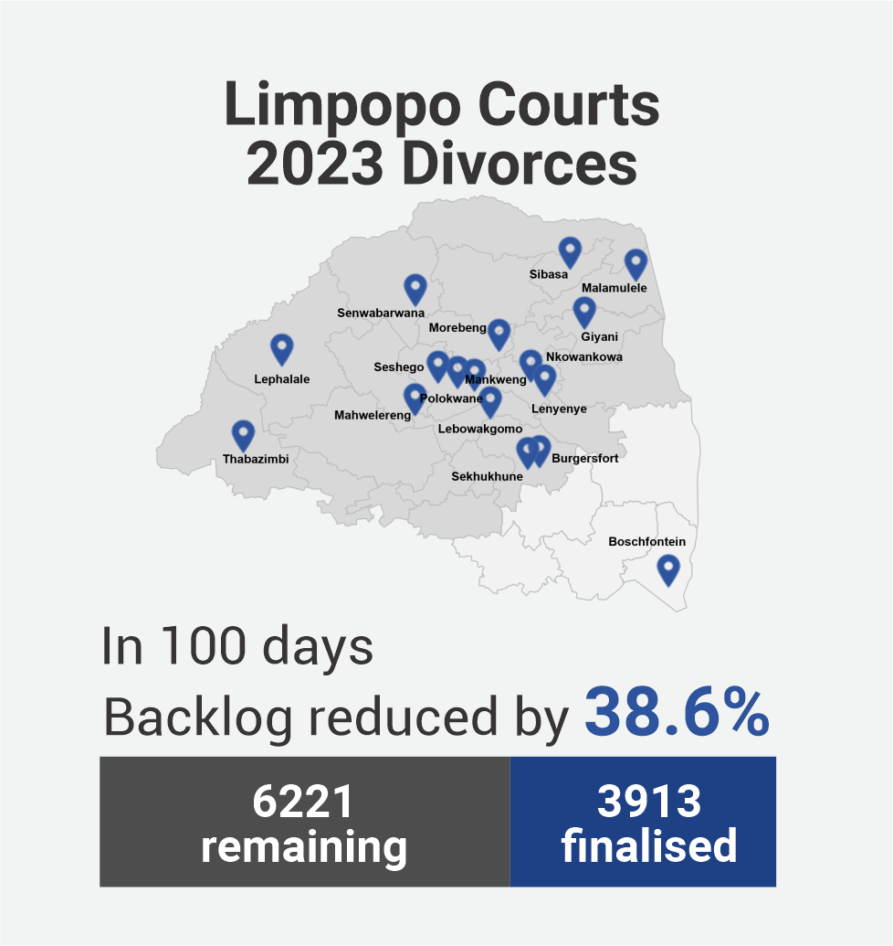
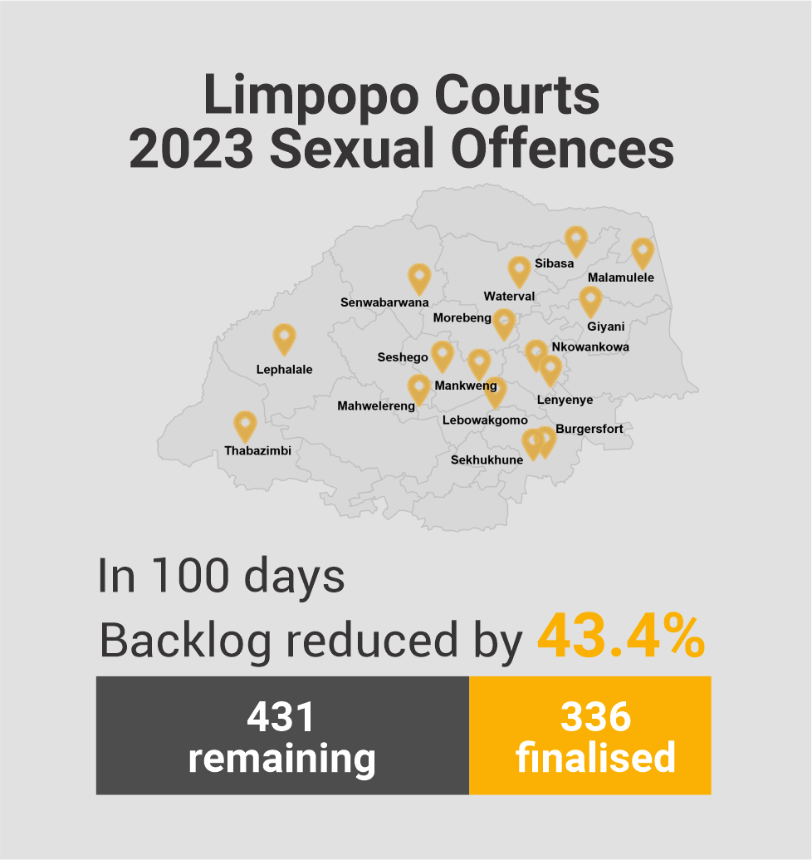
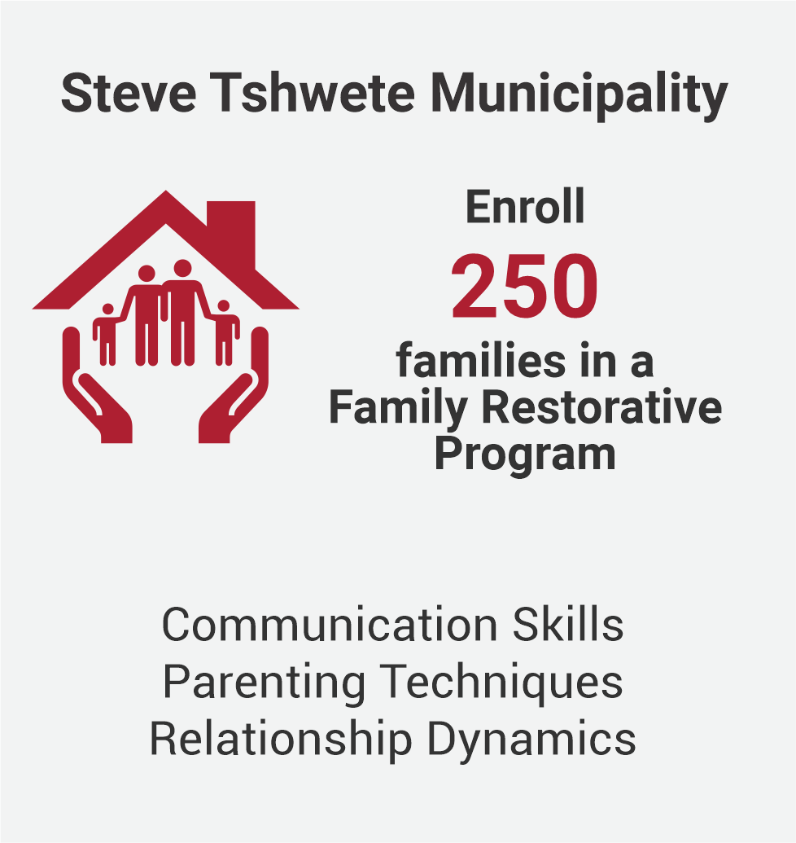
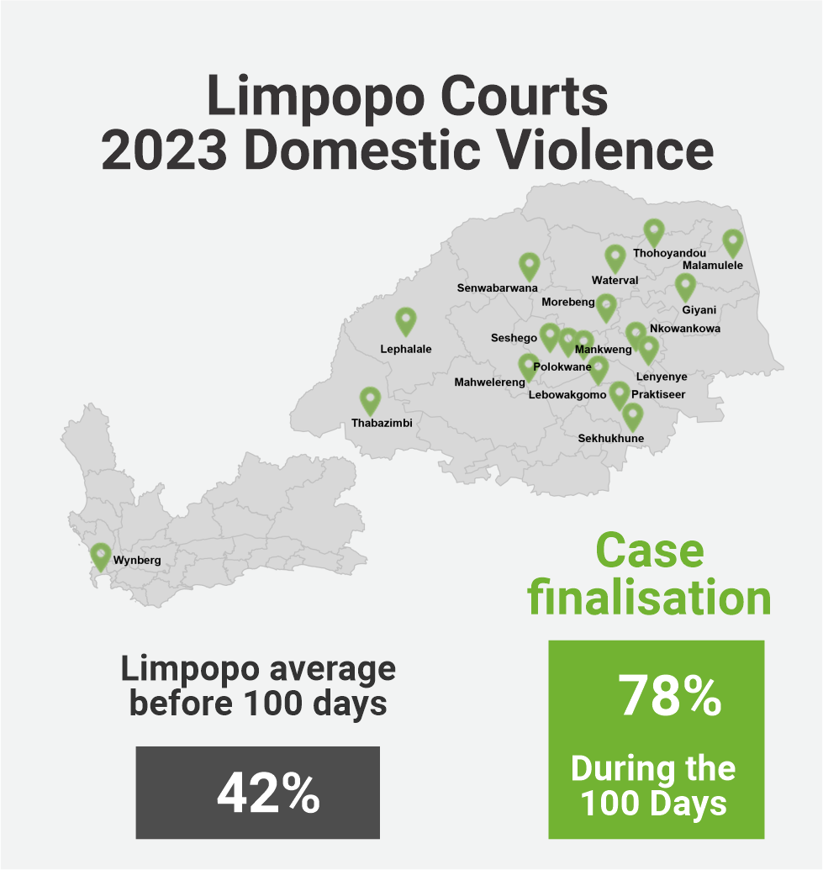
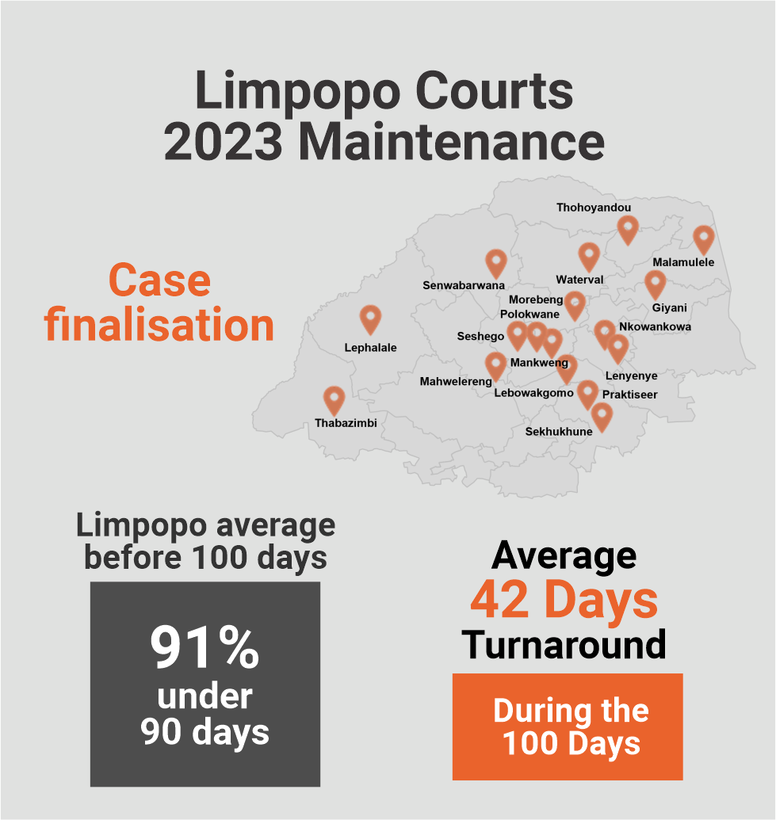
Some highlights from past Challenges

Slide 7



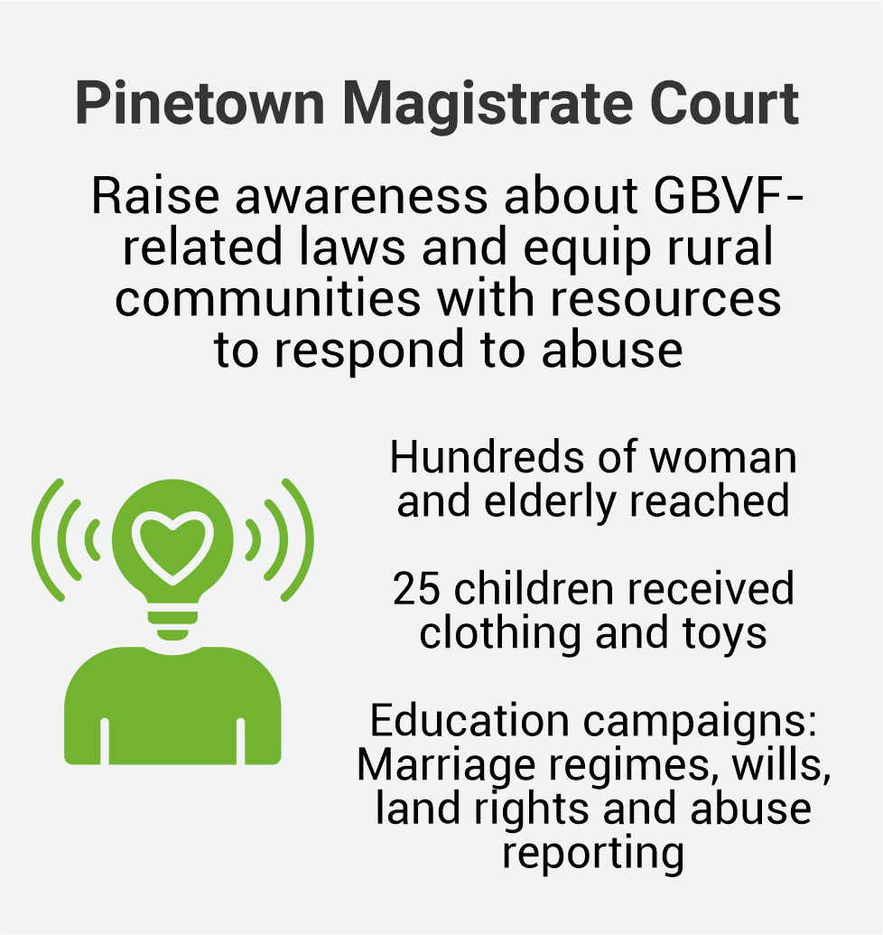

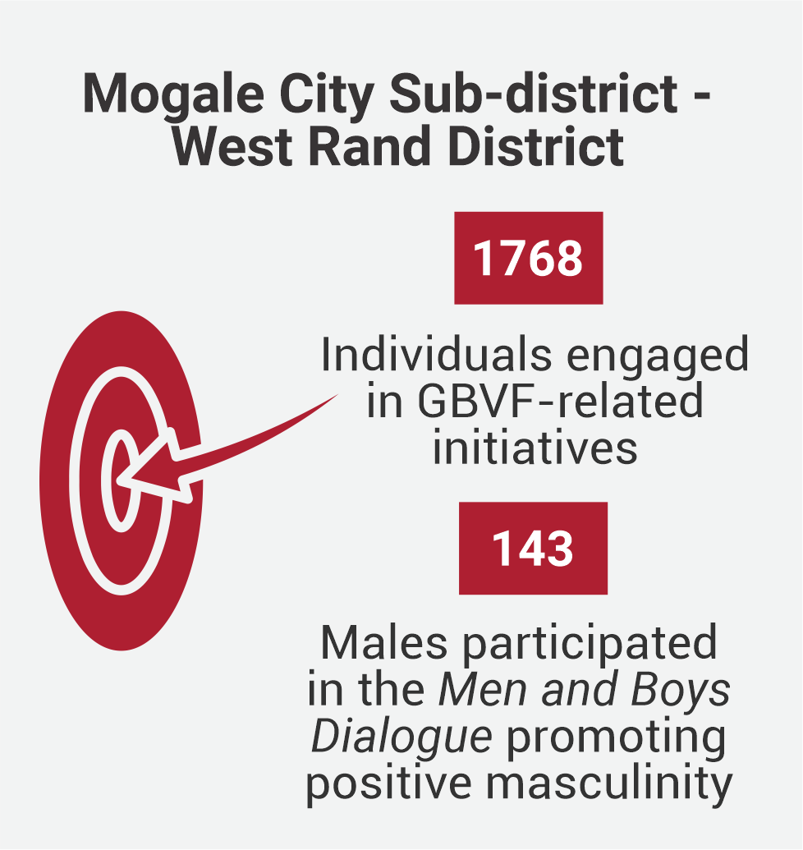

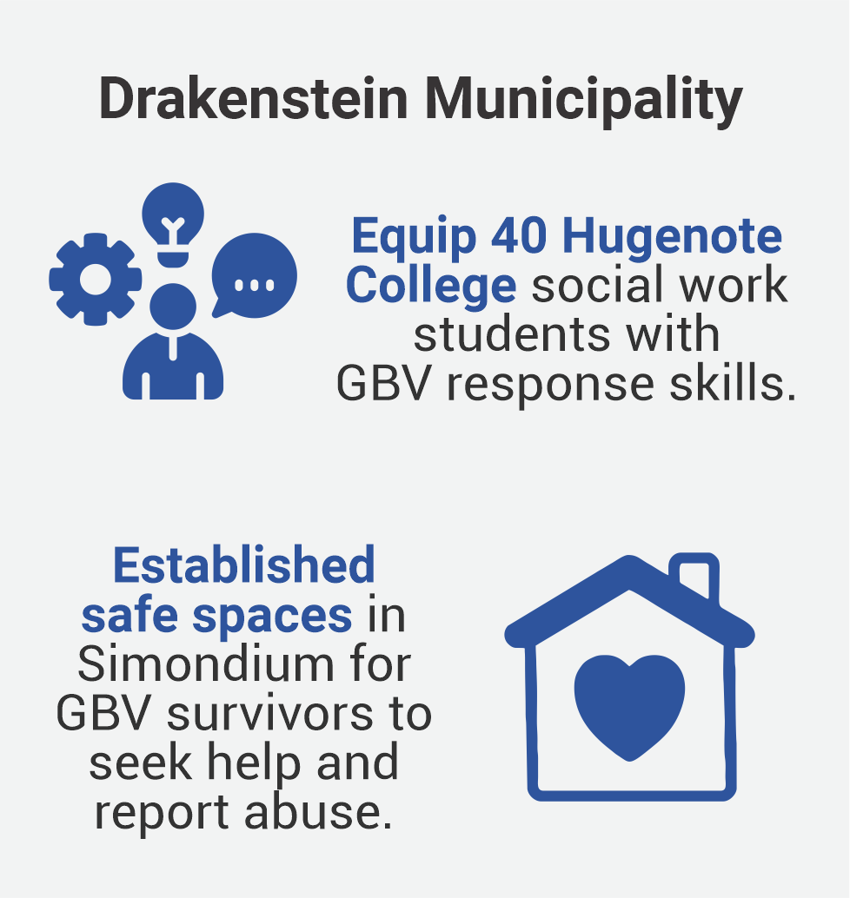
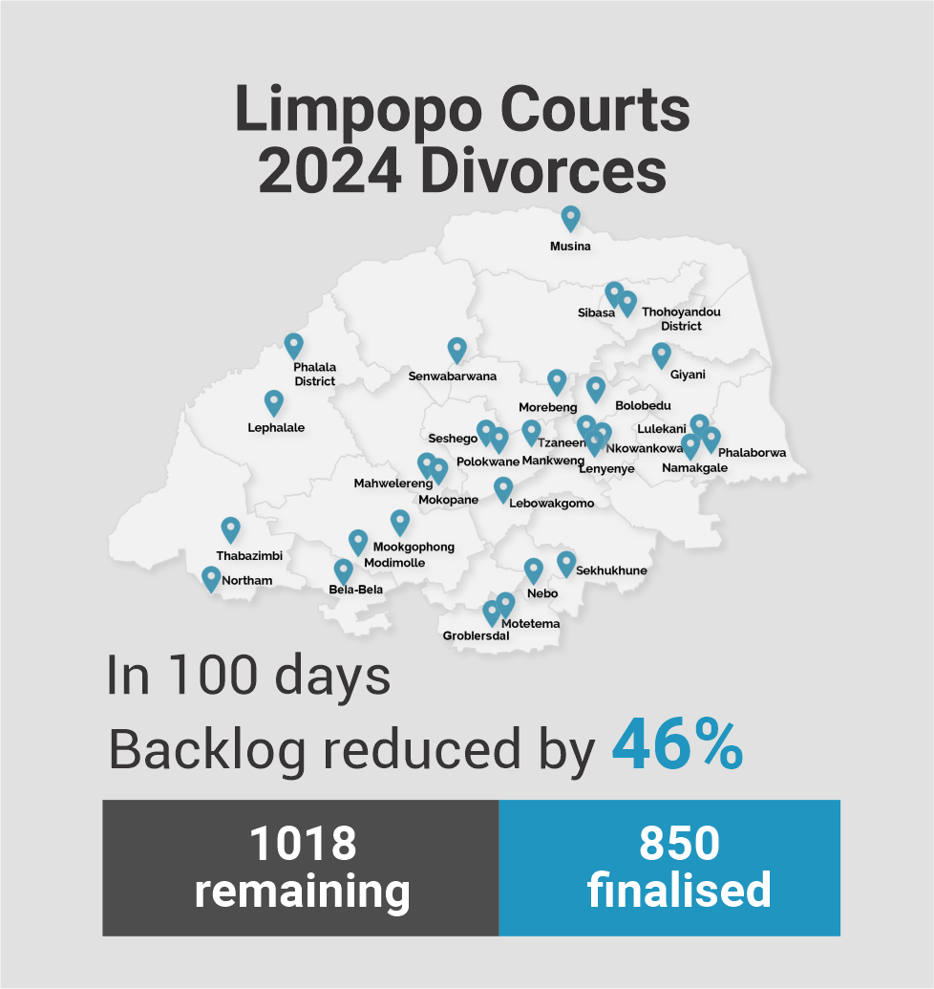
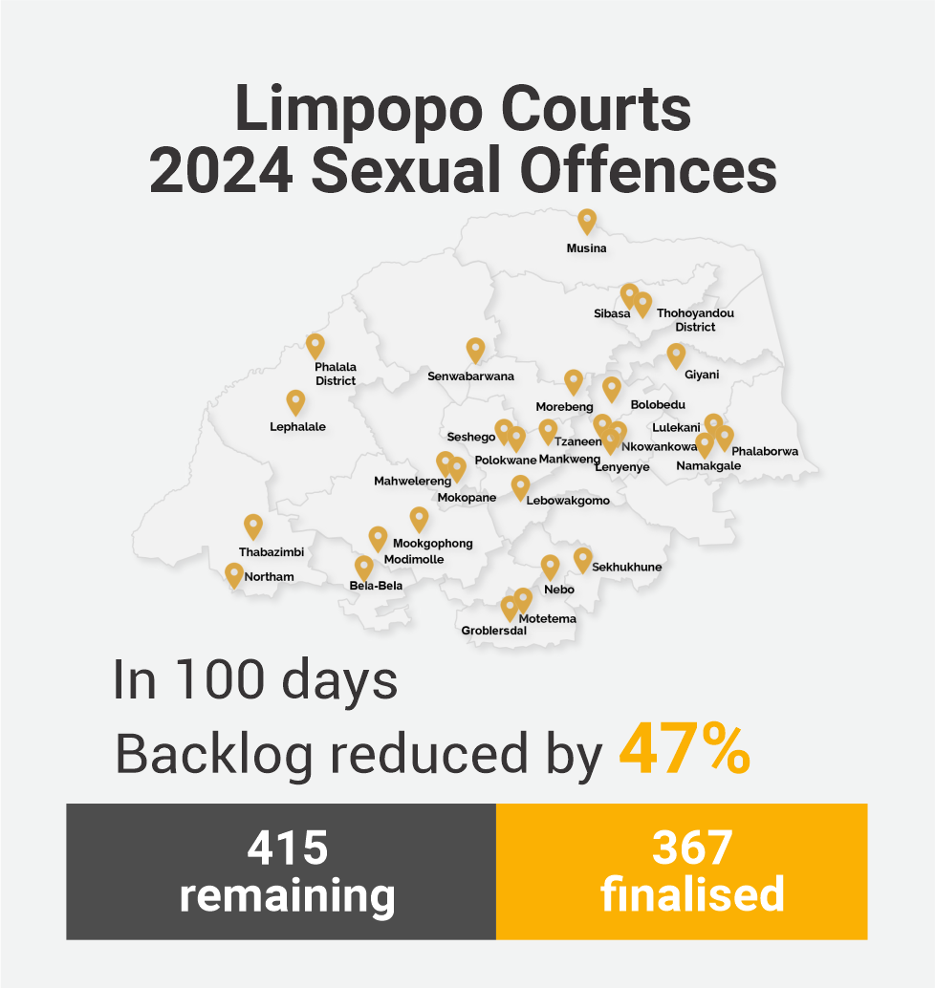
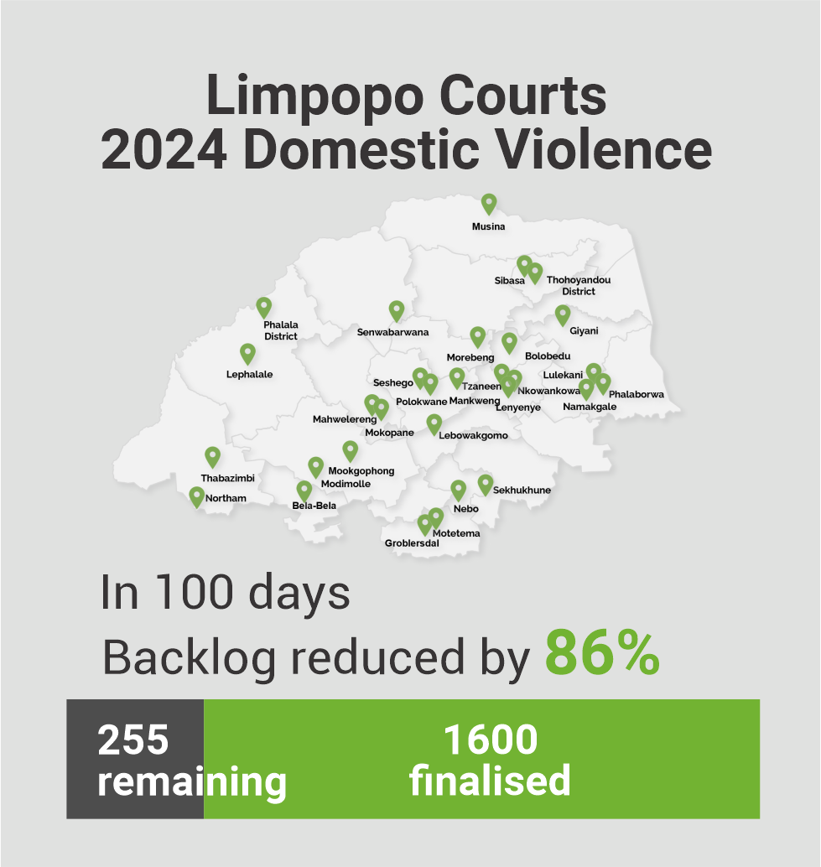
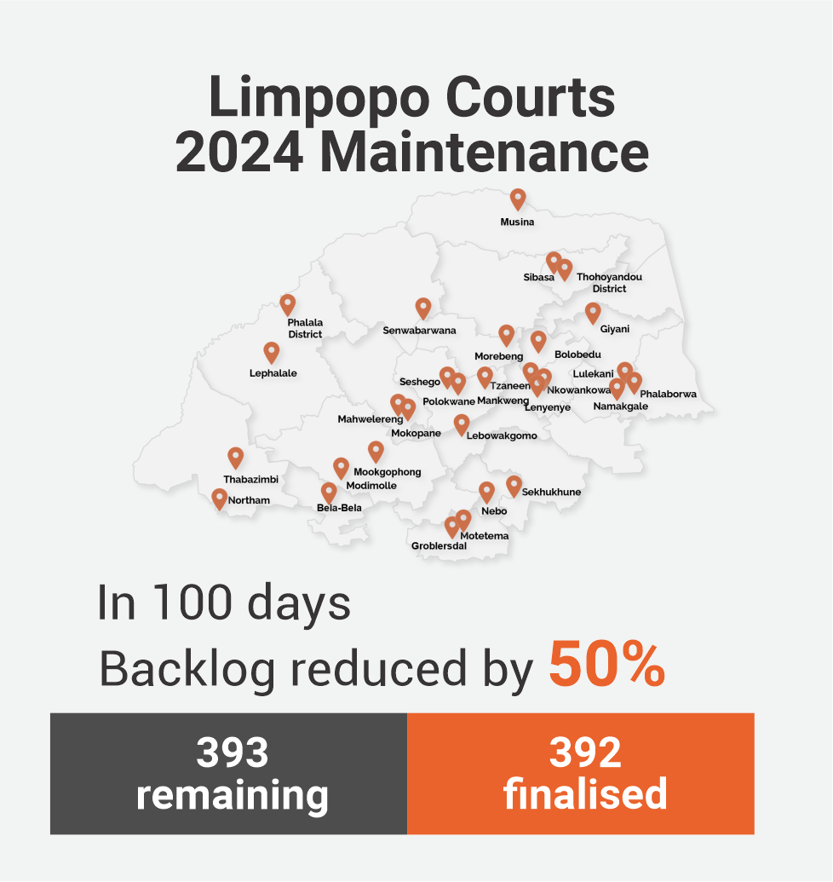
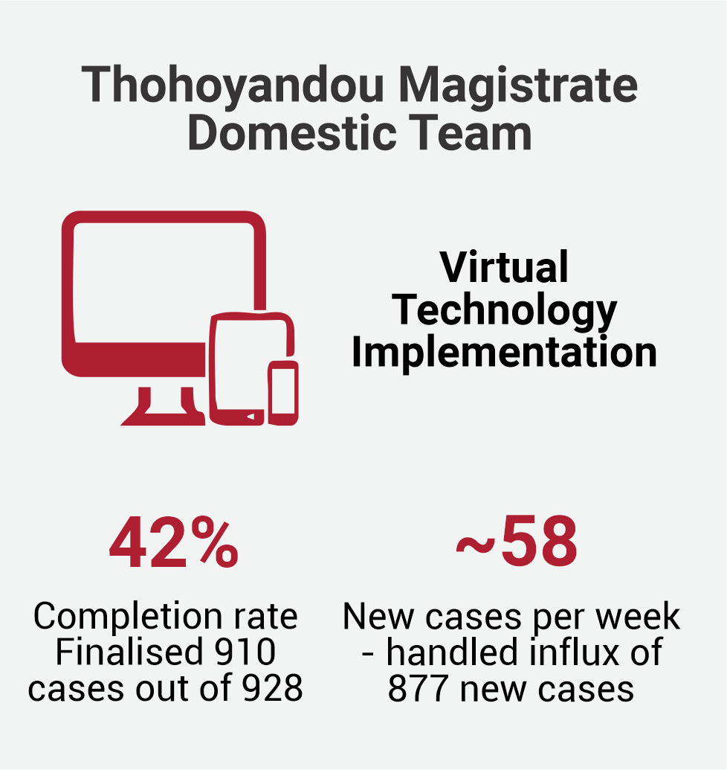
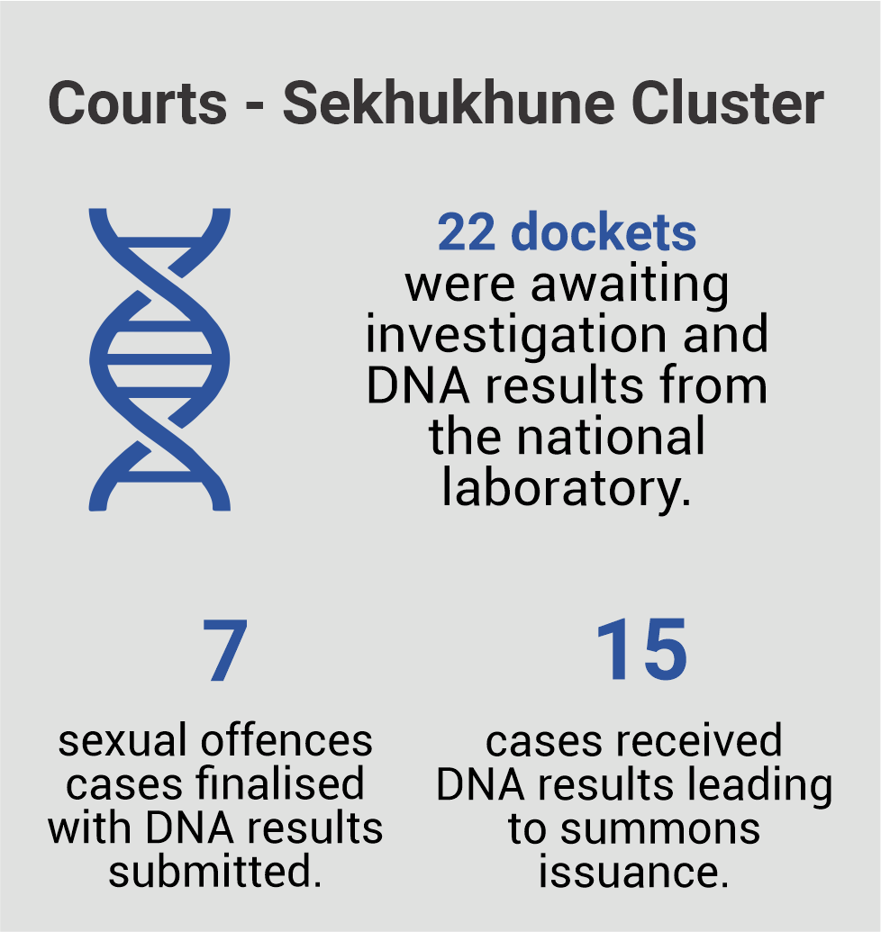
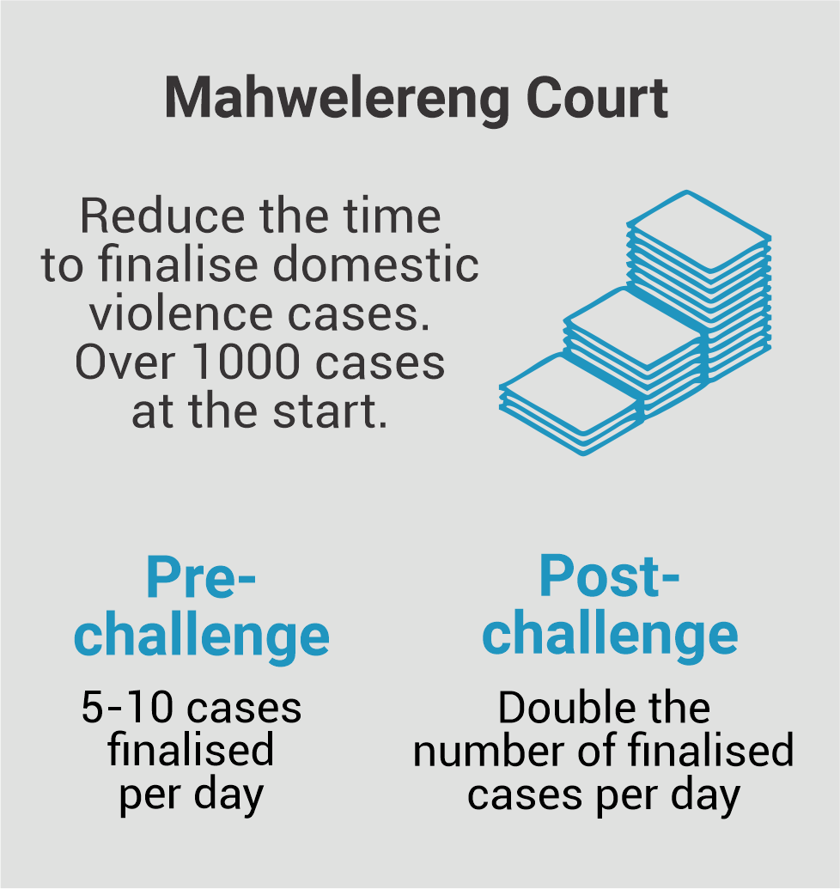
Some highlights from past Challenges

Slide 8



Workshop Agreements
Hear and be Heard
Every voice counts
All ideas are welcome
What else?
Look for Solutions
No blaming
No complaining
What else?
Respect Others
Listen
Be fully present
What else?

Slide 9
Understanding our 100-Day Challenge
Setting our 100-Day goal
Objectives
Shaping our Team Agreement
Developing our 100-Day Plan

Slide 10








What is a
100-Day Challenge?
It is a project
It lasts 100 days
    Like all projects, it has a…
A goal
A team
A plan
What makes it different?
It is designed to harness the power of crises, without creating a crisis!

Slide 11

What makes it different?

Slide 12

Crisis
100-Day Challenge
Sense of urgency
Fast - 100 days from project start to completion
Success, or even survival is far from guaranteed
100-Day Goal feels almost impossible to achieve
Inspire unusual behaviours
“All hands-on deck” - all focused on the crises
Right team is assembled, all committed to the goal
People ignore red tape, hierarchy and approvals
The Challenge team has full agency of their plan, to experiment and pivot during the 100 days

Slide 13

How will it work?

Slide 14




100-Day Challenge
Intense
collaboration
Fast - 100 days from project start to completion
100-Day Goal feels almost impossible to achieve
Inspires
Frequent
innovation
Right team is assembled, all committed to the goal
Disciplined implementation
100-day team has full agency of their plan, to experiment and pivot during the 100 days

Slide 15
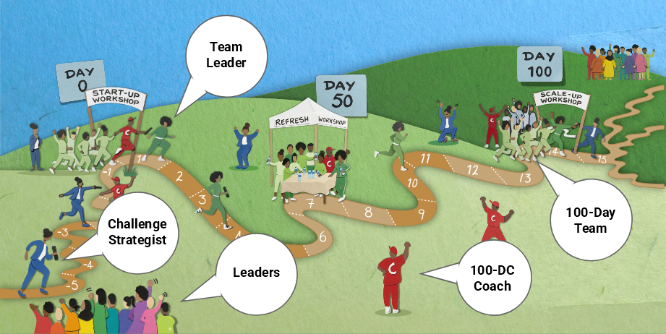
The 100-Day Relay Race

Slide 16


Roles
Leader’s role
Context: Select a Focus area from the strategy
Actors: Select the 100-Day team (8-12 members) and the Team Coach.
Challenge and support the selected team
Challenge Strategist
100-DC Team
Team’s Role
Goal: Set 100-Day Goal
Plan: Develop and implement the 100-day Work Plan
Team: Elect team leaders & shape team agreement
Local Leaders
100-DC Coach
Team Leader
Team coach role
Facilitate Team Workshops
Coach Team Leader
Guide the team through the Relay Race

Slide 17
Understanding our 100-Day Challenge
Setting our 100-Day goal
Objectives
Shaping our Team Agreement
Developing our 100-Day Plan

Slide 18

Tennis Ball Challenge

Slide 19

The Story of Jeha

Slide 20

Shaping our 100-Day Goal
OUTCOME - Visible & Tangible benefit to “customers”
“WOW” factor – highly visible
EASY to MEASURE – frequently and cheaply
EASY to UNDERSTAND – Grandmother understands & newspaper headline
Fully OWNED by the team
What makes a solid 100 Day Goal?

Slide 21

SMURF not SMART Goal!
S = Strategic
M = Measurable
U = Unreasonable
R = Results-Oriented
F = Fast

Slide 22
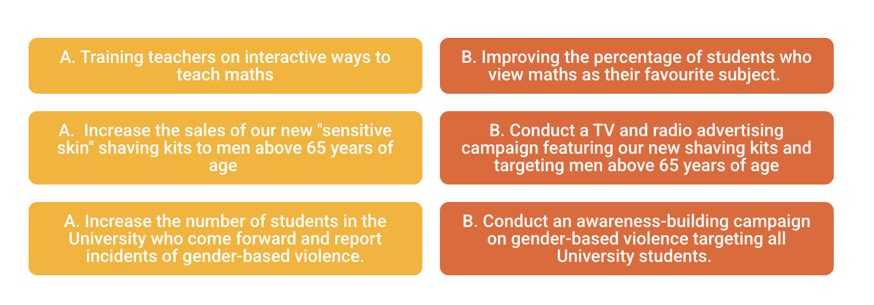
Which is a better 100-Day Goal?

Slide 23
Is it clear what the baseline is? If not, how will the team measure it? Compared to this baseline, does the goal still feel “unreasonable”?
When will we start measuring progress towards the goal? And how often we will measure progress after that?
Is the goal framed as “In 100 days,... OR “Within the last month of the 100 days…?” Which framing is more suitable?
Refining the Goal
What are possible adverse consequences of achieving this goal? What are ways to ensure that the team mitigates these risks?

Slide 24
Understanding our 100-Day Challenge
Setting our 100-Day goal
Objectives
Shaping our Team Agreement
Developing our 100-Day Plan

Slide 25

Team leader election and team agreement
Role
Helps team members stay organised and focused on the goal.
Coordinates, as needed, with the Challenge Strategist
Leads weekly team meetings
Electing our team leader
Submit 1 or 2 names (you can nominate yourself)
Let’s vote
Not necessarily the most vocal, but one who can bring team members together

Slide 26



Our
Team Agreement
Team structure
Who will play the role of data geek and storyteller? What other roles do we need?
What name do want to call our team, if any?
Who else to invite to join the team?
Management rhythm
When and where will we have our weekly meeting?
How and who will brief new team members?
How we will work together
How will we hold each other accountable?
What will we do to make our collaboration fun and exciting?
What else?

Slide 27
Understanding our 100-Day Challenge
Setting our 100-Day goal
Objectives
Shaping our Team Agreement
Developing our 100-Day Plan

Slide 28






Workplan
Step 1 - Generate ideas
Step 2 - Cluster ideas into themes
Step 3 – Create thematic plan and actions
Step 4 – Synch the plan
Our roadmap for the
next 100 days
Step 5 – Stress-test the plan

Slide 29

Generate Ideas
Brainstorm ideas using post-it notes.
Think about actions, ideas, or strategies that can help them make progress towards the 100-Day Goal.
Write one action/idea/strategy on a post-it note.
Any wild ideas that is not related to doing the current things better?

Slide 30

Generate Ideas
Fun activities
Play 3 truths and a lie
Ask each for their favourite food
Assign each guest an activity to run
Goal: In 100 days, organise a dinner party for 20 friends that 80% of them will rate as the “most amazing party” they have ever been at.
Ask each friend for their favourite music
Brind a band that they all like
Organise the dinner seating carefully
Note: These post-it’s are just examples
Build excitement leading up to the party
Ask each to bring something to share with others (could be editable or not)

Slide 31
Cluster similar ideas into themes
Group post-its that go together
Label each cluster with a heading (e.g. Music selection)
Fun activities
Activities selection & organising
Assign each guest an activity to run
Food selection & preparation
Organise the dinner seating carefully
Play 3 truths and a lie
Ask each for their favourite food
Music selection
Conversations
Brind a band that they all like
Note: These clusters are just examples
Build excitement leading up to the party
Ask each to bring something to share with others (could be editable or not)
Ask each friend for their favourite music

Slide 32

Create thematic plans and actions
Review the post-it’s and turn these into an actions
  One action per post-it note
  Action steps starts with an action verb.
Label the swim lane according to themes
Place action post-it’s on the timeline of the theme (You can add a sub-goal to the swim lane)
Add a responsible person on each action
Select one person to look after the actions in a theme swim lane
Team leader
Assign each cluster of ideas to 2-3 team members (sub groups)
In Subgroups

Slide 33
Swimlanes (and actions)
Food selection & preparation
Action
Action
Action
Action
Food selection
Action
Action
Action
Swim Lanes
Activities selection & organising
Action
Action
Action
Music selection
Action
Action
Action
Action
Conversations
Action
Action
Week
1
Week
2
Week
3
Week
4
Month
2
Month
3
Day 30
Day 60
Day
100

Slide 34

Sync up the thematic plans
  Do the timings across workstreams match up?
  Do we need to move the post-it’s around on the timeline?
  Any gaps?
  Are there too many actions in one week or month?
  Additional team members to recruit?
  Other leaders to reach out to?
  What else?
All team members review the full plan
(all workstreams)

Slide 35




Stress-test the 100-Day Plan
Do the work streams add up to the 100-day Goal? If not, what else to do?
What could go wrong with the Plan? What risk mitigating steps can we add?
Who volunteer to transcribe the plan on the work-planning template.
Do we need to add actions on:
      Assessing the baseline, or creating one if none exists?
      Creating a way to track progress against the goal?
      Communicating with key stakeholders?
Add Review sessions with the Challenge Strategist on the timeline

Slide 36



The Way Forward
Next
Steps
Convert swimlanes to work plan template, and share with the team
Schedule weekly team meetings.
Get baseline information on 100-Day Goal
Schedule check-in with the Team Coach and Challenge strategist
Send “hold the date” calendar For the Refresh Workshop

Slide 37
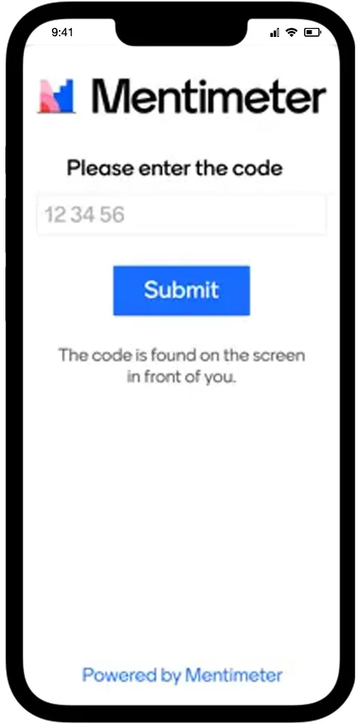
Workshop Feedback
Add your
Mentimeter code here
www.menti.com

Slide 38

Group Photo

Slide 39
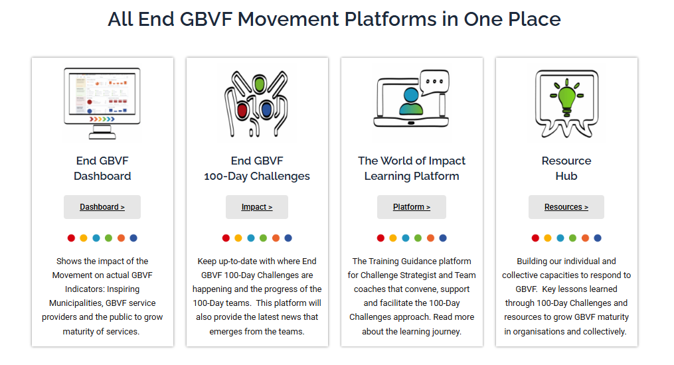

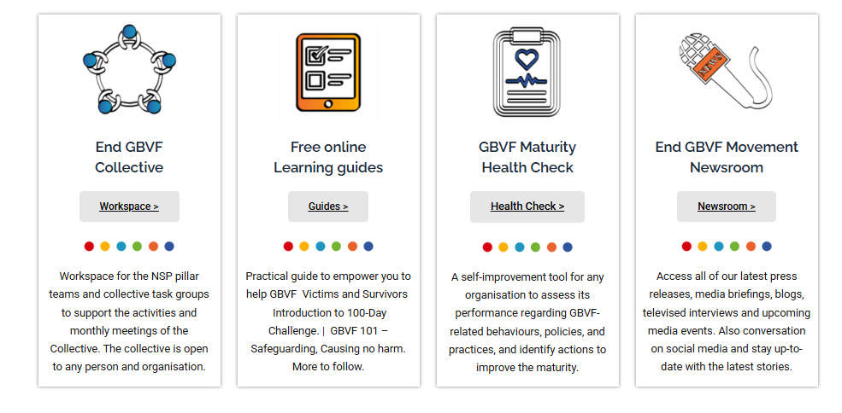

See what previous teams have done & Check out your project on the dashboard
#endGBVF #100dayimpact #100day4GBVF
www.endinggbvf.org

Slide 40


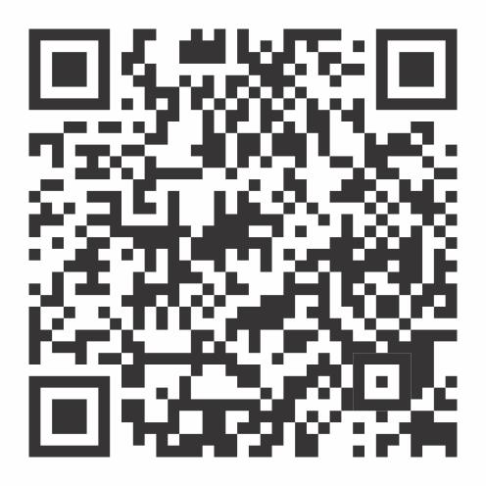
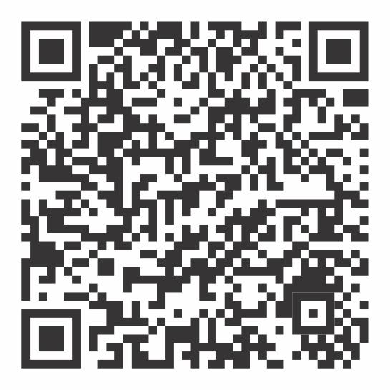


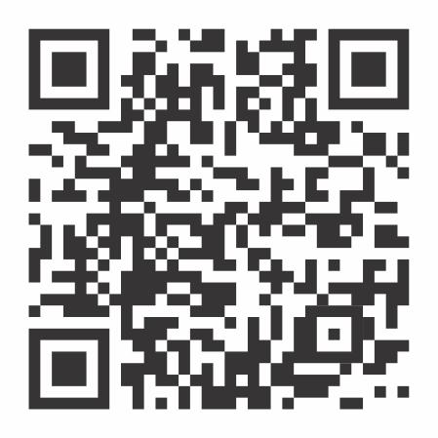
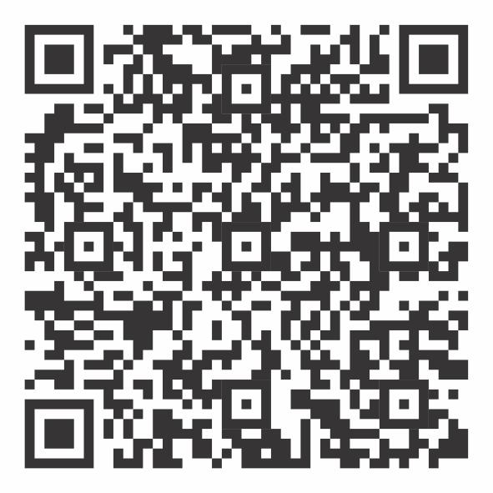

Other Movement tools
https://www.facebook.com/endgbvf100days
https://www.instagram.com/endgbvf_100daychallenges/
Follow your
team on
Social Media.
https://x.com/gbvf100days
https://www.linkedin.com/company/endgbvf-100-day-challenges

