Slide 1

Ending GBVF 100-Day Challenge
Leadership Briefing

Slide 2



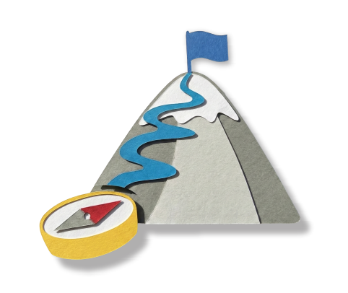
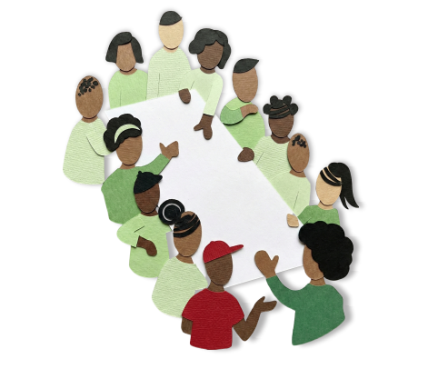
End GBVF Movement Context
What are 100-Day Challenges?
Discussion points
Focus of our 100-Day Challenge
100-Day Team Members

Slide 3








Localising the National Strategic Plan
1
Accountability,
Coordination and
Leadership
6
Research and
Information
Management
2
Prevention and Rebuilding Social Cohesion
5
Economic
Power
3
Justice,
Safety and
Protection
4
Response, Care, Support and Healing

Slide 4


Department of Social Development
Department of Women, Youth and Persons with Disability
Department of
HIgher Education and Training
End GBVF 100-Day
Challenge Conveners
Department
of Cooperative Governance and Traditional Affairs
Department of Monitoring and Evaluation (Office of the President)
South African Local Government Association (SALGA)
Department of Justice and Constitutional Development

Slide 5
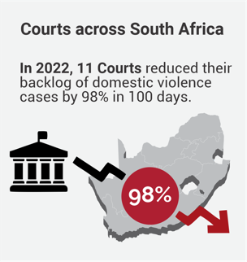
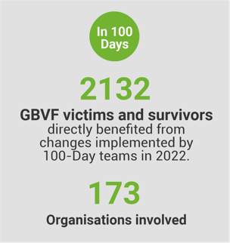
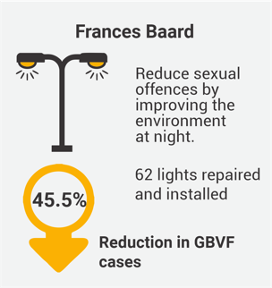
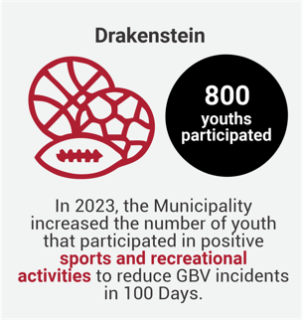
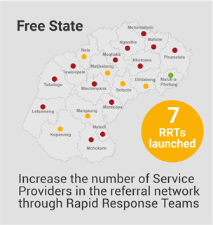
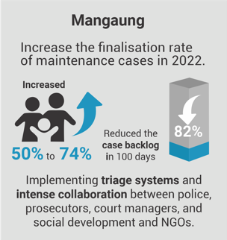
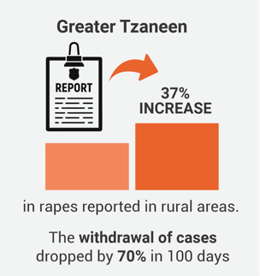
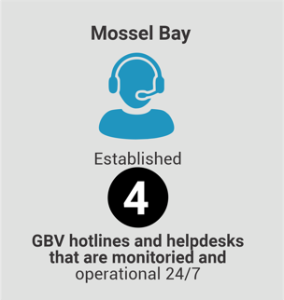
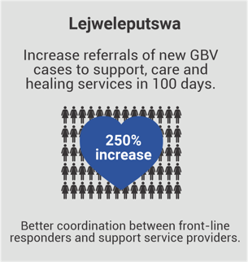

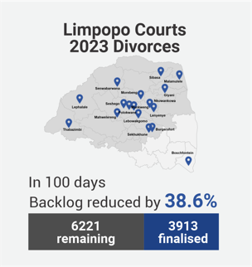
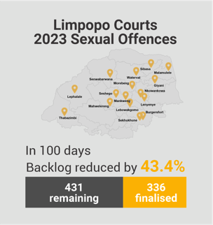
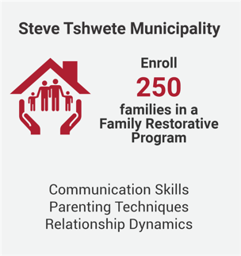
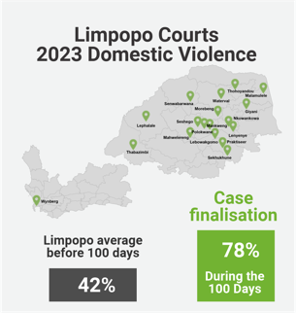
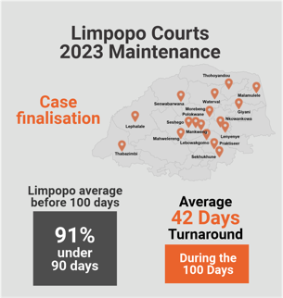
Some highlights from past Challenges

Slide 6
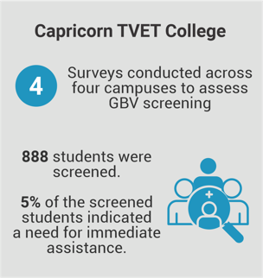


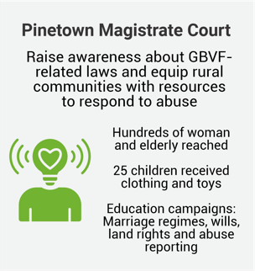

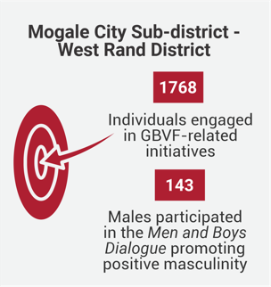

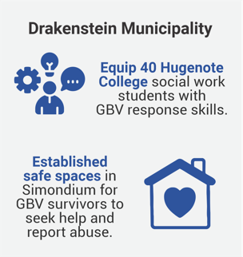
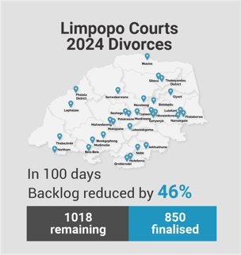
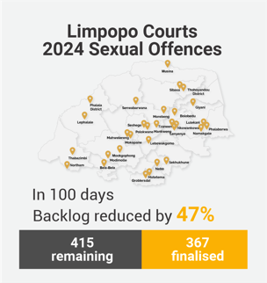
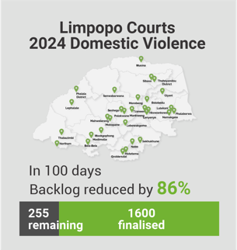
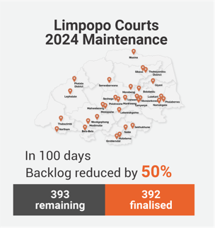
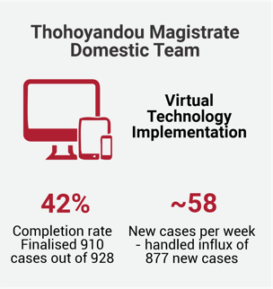
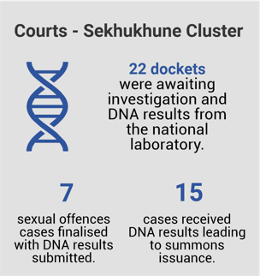
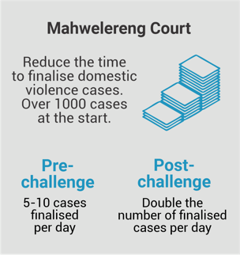
Some highlights from past Challenges

Slide 7
End GBVF Movement Context
What are 100-Day Challenges?
Discussion points
Focus of our 100-Day Challenge
100-Day Team Members

Slide 8









What is a 100-Day Challenge?
It is a project
It lasts 100 days
Like all projects, it has a…
A goal
A team
A plan
What makes it different?
It is designed to harness the power of crises, without creating a crisis!

Slide 9

What makes it different?

Slide 10




Crisis
100-Day Challenge
Sense of urgency
Fast - 100 days from project start to completion
Success, or even survival is far from guaranteed
100-Day Goal feels almost impossible to achieve
Inspire unusual behaviours
“All hands-on deck” - all focused on the crises
Right team is assembled, all committed to the goal
People ignore red tape, hierarchy and approvals
The Challenge team has full agency of their plan, to experiment and pivot during the 100 days

Slide 11





100-Day Challenge
Intense
collaboration
Fast - 100 days from project start to completion
100-Day Goal feels almost impossible to achieve
Inspires
Frequent
innovation
Right team is assembled, all committed to the goal
Disciplined implementation
100-day team has full agency of their plan, to experiment and pivot during the 100 days

Slide 12
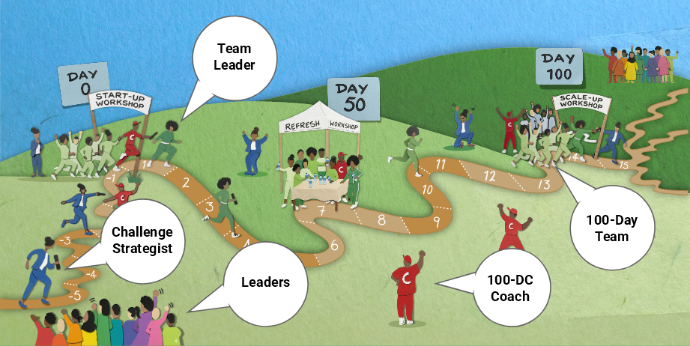
The 100-Day Relay Race

Slide 13
End GBVF Movement Context
What are 100-Day Challenges?
Discussion points
Focus of our 100-Day Challenge
100-Day Team Members

Slide 14




Focus of our 100-Day Challenge
Where in our GBVF ecosystem do we most urgently need fresh thinking, collaboration, and attention to implementation?
TVETs & Universities
Courts
Municipalities
Reduce backlog of cases. (Pillar 3)
Speed up time from filing to resolution. (Pillar 3)
Reduce withdrawal of cases (Pillar 3)
Improve the experience of court clients (model court). (Pillar 3)
Increase the procurement from women-owned businesses (Pillar 5)
Increase the number of support services that survivors of gender-based violence actually receive (Pillar 4)
Reduce the incidence of GBVF in “hot zones” (Pillar 2)
Reduce incidents of gender-related bullying in schools (Pillar 2)
Reduce incidents of sexual abuse in the workplace (Pillar 5)
Increase the number of safe spaces/shelters (Pillar 4)
Break the Silence: increase the number of survivors who come forward and report experiences of GBVF. (Pillar 2 & 4)
Heal the Wounds: Increase the number of survivors who receive high-quality care, support, and counselling so they can overcome the trauma of GBVF. (Pillar 4)
Create Deterrence: Increase the number of perpetrators held accountable through disciplinary actions in TVETs and courts. (Pillar 3 & 5)

Slide 15
End GBVF Movement Context
What are 100-Day Challenges?
Discussion points
Focus of our 100-Day Challenge
100-Day Team Members

Slide 16
100-Day Team Members
What to look for in team members
Involved or close to direct service delivery.
Interested in the topic and knowledgeable about it.
Team player – likes to collaborate with others.
Has expressed frustration about this issue in the past
Able to bring others along - respected by colleagues
Ready to ‘stretch their wings (developmental opportunity)
Offers new ideas - ready to take risks
The ideal team size is 8-12 individuals with diversity of perspectives and backgrounds.

Slide 17




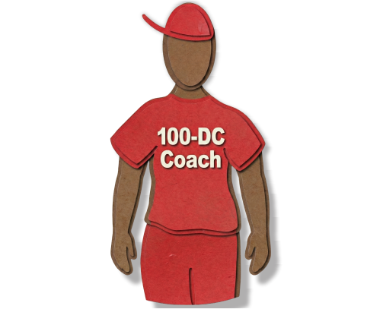

Countdown to Scale-up
Steps
to get
ready
Draft Challenge Note
to the team
Challenge Strategist
Challenge Strategist
Finalise team membership
Gather baseline
information on Focus area
Team
Coach
Send “hold the date” calendar
invitation to the Scale-up Workshop
Team Coach

Slide 18
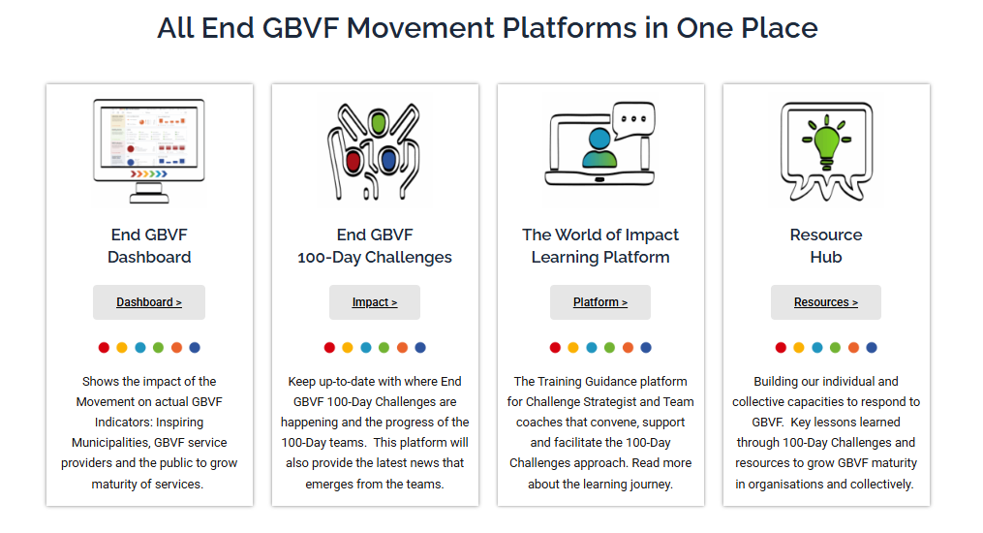

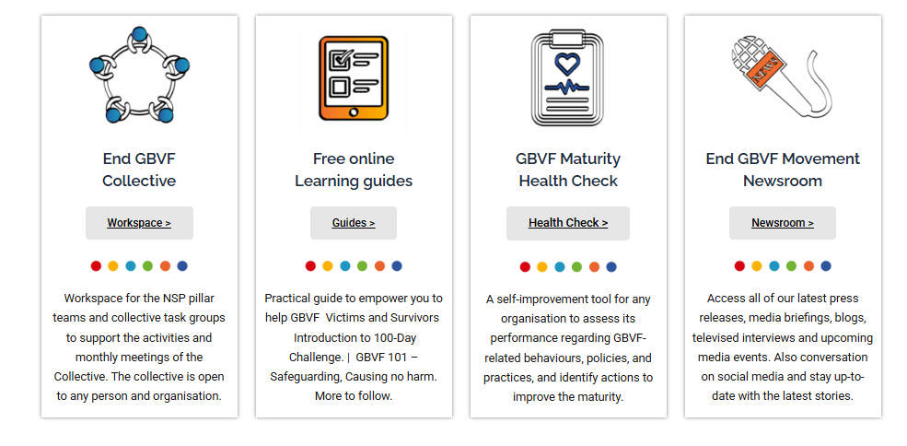

Other Movement tools
Go to the website.
All in one place.
www.endinggbvf.org

Slide 19


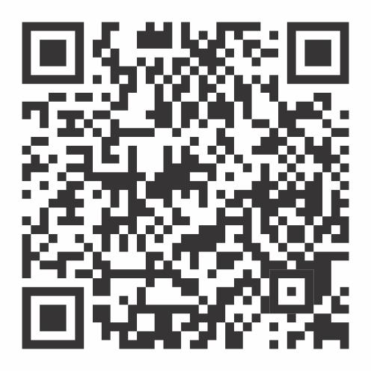
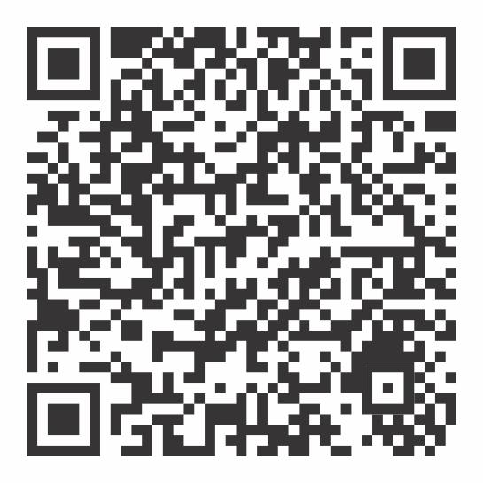


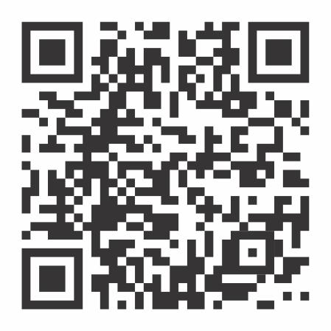
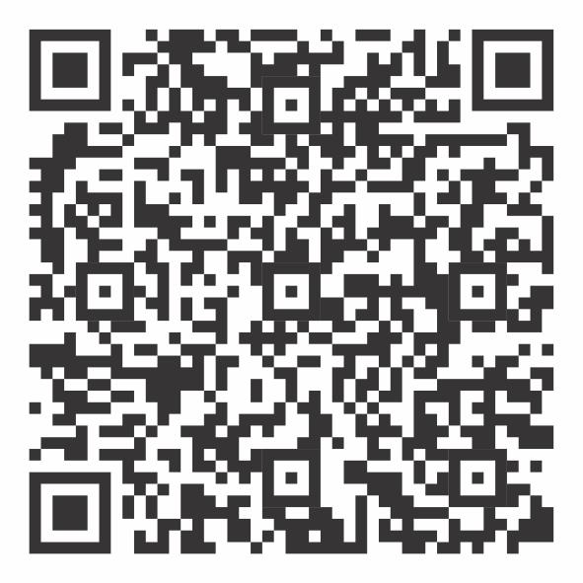
Other Movement tools
https://www.facebook.com/endgbvf100days
https://www.instagram.com/endgbvf_100daychallenges/
Follow your
team on
Social Media.
https://x.com/gbvf100days
https://www.linkedin.com/company/endgbvf-100-day-challenges

