Slide 1

GBVF Maturity 30-Day Challenge
Scale-up Workshop
Movement

Slide 2
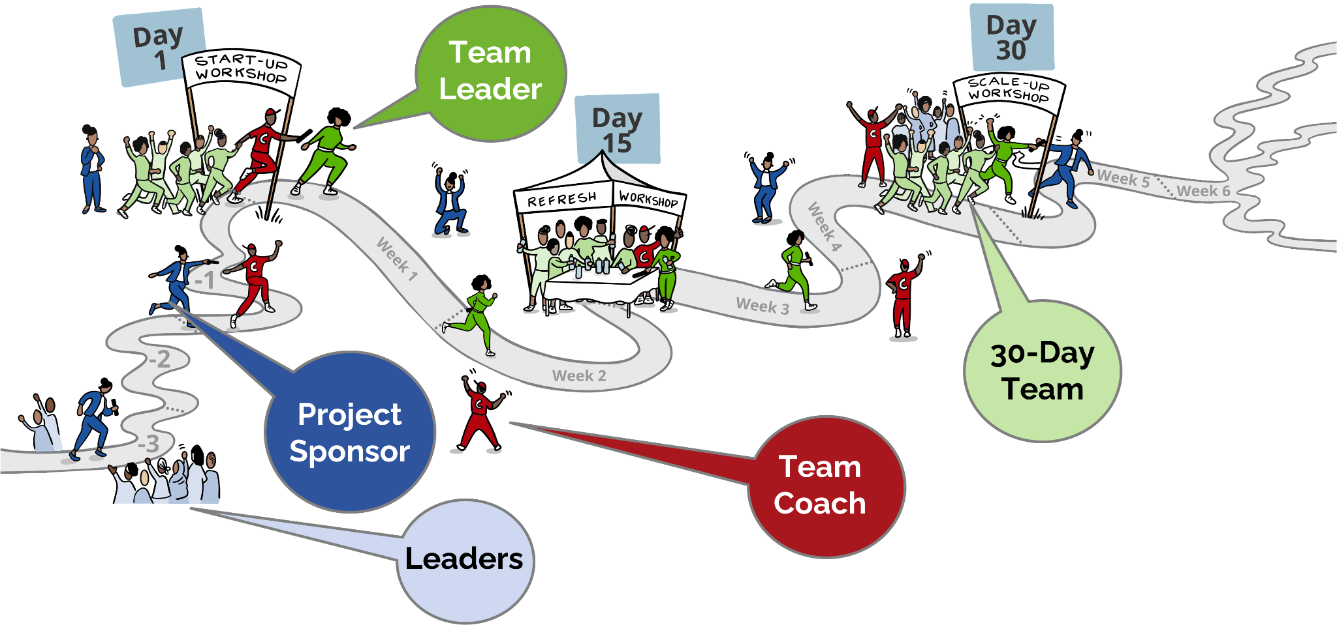
The 30-Day Project
Project

Slide 3





What we doing today
Share and Celebrate
Complete
the project
Sustain
the gains
Continue the GBVF Maturity journey
Reflect and close-out

Slide 4
Share & Celebrate
While the team present, those not part of the team make notes on:
Questions to ask afterwards
Team practices to try in other parts of the organisation
Suggestions for the team

Slide 5
Complete the project
Final sprint plan
(only use if team have outstanding actions)

Slide 6
Sustainability Recommendations
Final sprint plan
(Add the sustainability action recommendation the team developed in preparation for the workshop.)

Slide 7
Continuing the journey
Team’s idea
Follow-on 30-Day Project?
New focus area for 30-Day Project?
Multiple 30-Day Projects at once?

Slide 8

Reflection
On your phones
In your browsers go to
www.menti.com
Add your code

Slide 9

Appreciations

Slide 10
www.endinggbvf.org

