Slide 1

GBVF Maturity 30-Day Project
Refresh Workshop
Movement

Slide 2
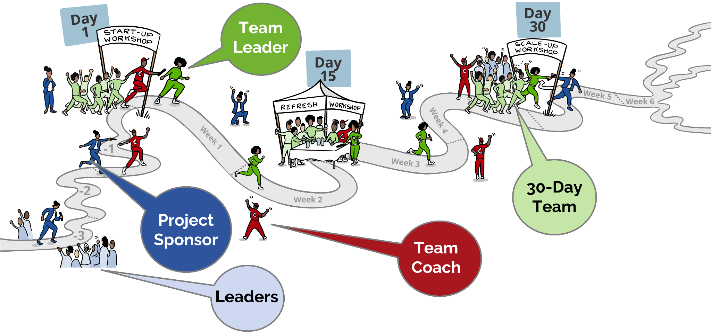
The 30-Day Project
Project

Slide 3




What We Are Doing Today
Review progress so far, and renew our commitment to the 30-day Goal.
Sharpen our plan:
Identify additional actions that can help us achieve our goal
Reflect on our Team Agreement:
What are we doing well? What do we need to change?
Talk with our sponsor and leaders - about the past, the present and the future

Slide 4

Getting Started...
What was one positive surprise about working on this Project?
What was a not so-positive experience?
What made you a little uncomfortable?

Slide 5
Project Progress
What are 2-3 things
the team did that
contributed the most
towards achieving the goal?

Slide 6

Goal Confidence
On a SCALE of 1-5 how confident are we that we will reach your 30-Day Goal?
1 = I feel we have no chance to reach our goal
5 = I am 100% certain we will reach our goal

Slide 7

Overcoming Obstacles - Troika
Troika Consulting
About giving and getting help
Form groups of 3
3 Rounds
with the same 3 people
In each round
1 person is the client
the other 2 are consultants/advisors
Everyone takes a minute to think of an obstacle that your team face that you would like help on (as a ‘client’)

Slide 8
Overcoming Obstacles - Troika
The clients shares an obstacles and answer clarifying questions
The advisors share ideas/experiments they think would be helpful for the client
After each round we change
roles but stay in the same group
IDEAS for advisors
Power through this? OR
Work around it? OR...
Shift your position or the destination?

Slide 9
Overcoming Obstacles - Troika
One advisor keeps an eye on the time.
We will announce
when a NEW ROUND must start.
In groups of 3 - choose someone to start as client.
1 min | Client shares an obstacle.
2 min | Advisors ask clarifying questions. No advice yet!
4 min | Client turns around facing away and advisors give ideas, suggestions and advice.
2 min | Client turns back and share their takeaways from the advice.
 | Next round - Pick the next client and repeat steps

Slide 10

Sharpening our 30-Day Plan
Translate the Troika advice into action steps in the work plan.
What else can the team do in the next part of the challenge to increase the odds of achieving the goal?
Prioritise if need be, and build into the plan.

Slide 11

Reflect on the team agreement
Add your
Mentimeter code here

Slide 12



Conversation with Leaders
Looking now
Looking Back
Looking forward
Assess progress?
Revised the goal?
New ideas to integrate into the Plan?
Support needed?
Advice and ideas to prepare for Sustainability & Scaling?

