Slide 1

GBVF Maturity 30-Day Project
Start-up Workshop
Movement

Slide 2

GBVF Maturity Health Check focus area
Purpose
Self-assessment of how we are doing on GBVF related behaviours, policies, and practices.
Help us identify areas to improve
Not a GBVF audit
Self-improvement tool
Guide GBVF Maturity journey
Our survey gaps
xxxxxxx

Slide 3




What we doing today
What is 30-Day Projects all about
Shaping our 30 day goal
Developing our team agreement
Developing our work plan

Slide 4









What is a
30-Day Challenge?
It is a project
It lasts 30 days
    Like all projects, it has a…
A goal
A team
A plan
What makes it different?
It is designed to harness the power of crises, without creating a crisis!

Slide 5







Our
GBVF Maturity
30-Day Project
It is a 30-Day Project
Informed by GBVF Health Check
Focused on one “pain point” revealed in the GBVF Health Check
Aimed at improving GBVF “maturity score” of the organisation

Slide 6

Examples of GBVF
30-Day Projects
1. Within 30 days, we will develop a policy on maternity and paternity leave, and we will get this approved by HR and the management team.
2. Within 30 days, we will ensure that at least 80% of staff are aware of the procedures for reporting incidents of sexual harassment in the workplace. We will measure this using “yes/no” text message to all staff.
3. During the last week of our 30-Day Project, we will have zero instances of unsolicited sexual advances in the workplace, using a quick poll of all staff to verify our performance.
Notes:
Which of these three project goals may be relevant in your organisation? Put number in the chat.

Slide 7

What makes it different?
A 30-Day Project is a 100-Day Challenge on steroid….
Just simpler and faster and internally in an organisation

Slide 8

How will it work

Slide 9


30 & 100-Day Challenge
Crisis
Sense of urgency
Fast - 30 or 100 days from project start to completion
Success, or even survival is far from guaranteed
30 or 100-Day Goal feels almost impossible to achieve
Inspire unusual behaviours
“All hands-on deck” - all focused on the crises
Right team is assembled, all committed to the goal
People ignore red tape, hierarchy and approvals
The Challenge team has full agency of their plan, to experiment and pivot during the 30 or 100 days

Slide 10
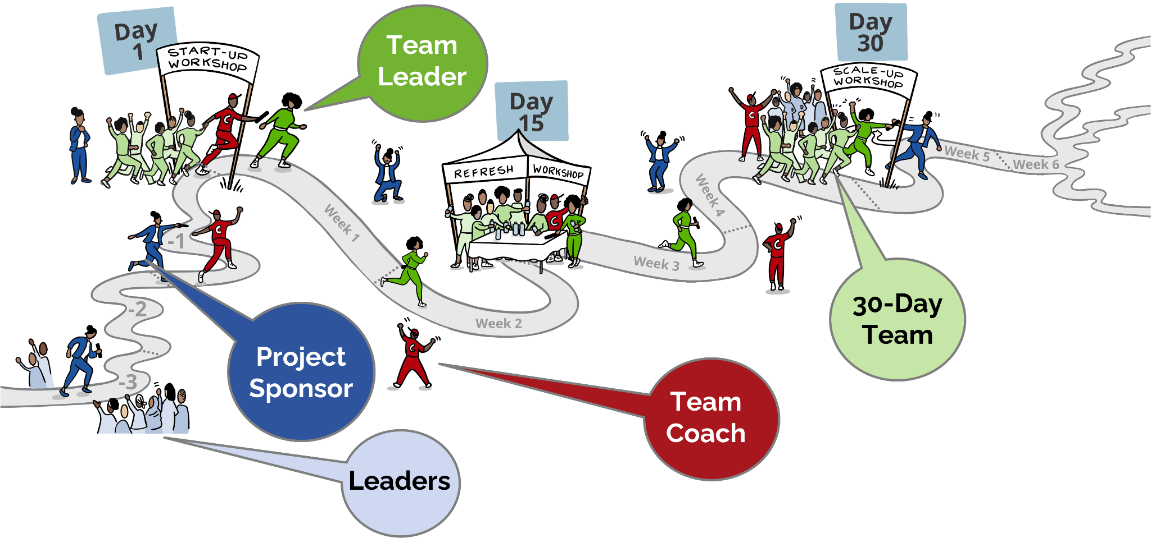
The 30-Day Project as Relay Race
Project

Slide 11
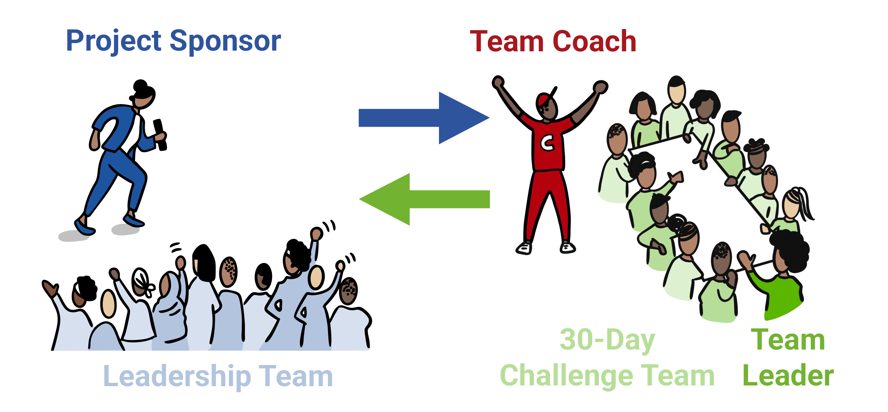
Roles
Context - Review Health Check Survey results
Focus – Decide on behaviour, practice, or policy to focus on
Actors - Select the 30-Day team (4-8 staff members) and Team Coach.
Goal: Set 30-Day Goal
Plan: Develop and implement the 30-day Work Plan
Team: Elect team leaders & shape team agreement
Facilitate the workshops and coach the team leader

Slide 12

Shaping our 30-Day Goal
OUTCOME - Visible & Tangible benefit to “customers”
“WOW” factor – highly visible
EASY to MEASURE – frequently and cheaply
EASY to UNDERSTAND – Grandmother understands & newspaper headline
Fully OWNED by the team
What makes a good 30 day goal?

Slide 13

SMURF not SMART Goal!
S = Strategic
M = Measurable
U = Unreasonable
R = Results-Oriented
F = Fast

Slide 14
Policy goal templates
Creating a
new policy
Disseminating an
Existing Policy
Moving from
policy to action
Within 30 days, we will develop a policy/process for __________, and we will get this approved by _____ and by the management team
Within 30 days, we will ensure that at least ____% of staff are aware of the policy about _____________. We will measure this using “yes/no” text message to all staff
During the last ___ weeks of November, ____ % of staff who report a ______ incident will receive _________ support within ____ hours, and a proper investigation will get underway within ____ hours.

Slide 15
Behaviour goal templates
Breaking
the silence
Healing
the wounds
Changing
the culture
Within 30 days, we will increase the number of staff members who file complaints (or speak up about) __________ from ___ per week to ____ per week.
During the last ___ weeks of November, ____ % of staff who report a ______ incident will receive _________ support within ____ hours, and a proper investigation will get underway within ____ hours.
The last week of November will be a “GBVF model week”, where we will have ___ incidents of ______. We will measure this through a yes/no text survey to all staff (asking if they experienced or or observed any type of ________________)

Slide 16

Compared to this baseline in the GBVF Health Check survey, does the goal feel really “unreasonable”?
When will we start measuring progress towards the goal and how often will we track the progress?
Is the goal framed as “In 30 days,... OR “Within the last week of the 30 days…?” OR "During the 30 days after the Project..." Which framing is more suitable?
Refining the Goal
What are the possible adverse consequences of pursuing this goal? What are ways to ensure that the team mitigates these?

Slide 17

Team leader election and team agreement
Role
Helps team members stay organised and focused on the goal.
Coordinates, as needed, with the Mentor
Leads weekly team meetings
Electing our team leader
Submit 1 or 2 names (you can nominate yourself)
Let’s vote
Not necessarily the most vocal, but one who can bring team members together

Slide 18

Team structure
Who will play the role of data geek and storyteller? What other roles do we need?
What name do want to call our team, if any?
Who else to invite to join the team?
Management rhythm
When and where will we have our weekly meeting?
How and who will brief new team members?
How we will work together
How will we hold each other accountable?
What will we do to make our collaboration fun and exciting?
What else?
Our
Team Agreement

Slide 19






Workplan
Step 1 - Generate ideas
Step 2 - Cluster similar ideas into themes
Step 3 – Create a plan for each theme, on a 30-Day timeline
Step 4 – Make sure these thematic plans synch up with each other, and add up to the 30-Day Goal
Our roadmap for the
next 30 days

Slide 20

Generate Ideas
Think about things the team can do to achieve the 30-Day goal (these could be actions, ideas, etc.)
Write one “thing’ on a post-it note.
Place the post-it randomly on the wall
If all the ideas are “business as usual”.
challenge the team to come up with one or two new ideas!

Slide 21

Generate Ideas
Fun activities
Play 3 truths and a lie
Ask each for their favourite food
Assign each guest an activity to run
Goal: In 30 days, organise a dinner party for 20 friends that they 80% of them will rate as the “most amazing party” they have ever been at.
Ask each friend for their favourite music
Brind a band that they all like
Organise the dinner seating carefully
Note: These post-it’s are just examples
Build excitement leading up to the party
Ask each to bring something to share with others (could be editable or not)

Slide 22
Cluster similar ideas into themes
Group post-its that go together
Label each cluster with a heading (e.g. Music selection)
Fun activities
Activities selection & organising
Assign each guest an activity to run
Food selection & preparation
Organise the dinner seating carefully
Play 3 truths and a lie
Ask each for their favourite food
Music selection
Conversations
Brind a band that they all like
Note: These clusters are just examples
Build excitement leading up to the party
Ask each to bring something to share with others (could be editable or not)
Ask each friend for their favourite music

Slide 23
Workstream/swimlanes (and actions)
Food selection & preparation
Action
Action
Action
Action
Team’s
30-Day
Goal
Food selection
Action
Action
Action
Swim Lanes
Activities selection & organising
Action
Action
Action
Music selection
Action
Action
Action
Action
Conversations
Action
Action
Week
1
Week
2
Week
3
Week
4
Month
2
Month
3
Day 30
Day 60
Day
100

Slide 24
Create a thematic plan and actions
Before the session, you had created a blank timeline with several “swim lanes” on flip charts. Each swim lane will be used to turn a cluster of post-its into a thematic plan
Subgroups and action steps
Label swim lane with a theme
Possible subgoals
Responsibilities
Solicit the help of the Team Leader to assign each cluster to 2-3 team members (sub-group).
Review the post-it’s and turn these into an organised plan, in one swim lane.
The plan consists of a number of action steps written out on a post-it notes and placed in the appropriate sequence and timing in their respective swim lane.
Each sub-group will label their swim lane with the theme of the cluster.
The swim lane will capture all the action steps related to its particular theme.
Note that each of these action steps starts with an action verb.
The sub-groups can add a sub-goal to its swim lane.
This typically relates to the 30-Day Goal, but it is focused on the particular theme.
The sub-group suggests a Team member to be responsible for making sure that each action step happens.
The name of the Team member is added to the post-it note.

Slide 25

Synch up the thematic plans
  Do the timings across workstreams match up? Do we need to move the post-it’s around on the timeline?
  Any gaps? Are there too many actions in one week or month?
  Additional team members to recruit?
  Other leaders to reach out to?
  Communication steps to inform others?
  Data we need to chase?
  What else?
The whole Team looks over all the swim lanes to see if the timing between them synchs up.

Slide 26

Workshop Feedback
Add your
Mentimeter code here

Slide 27

Group Photo

