Slide 1
Scale-up Workshop
Movement

Slide 2
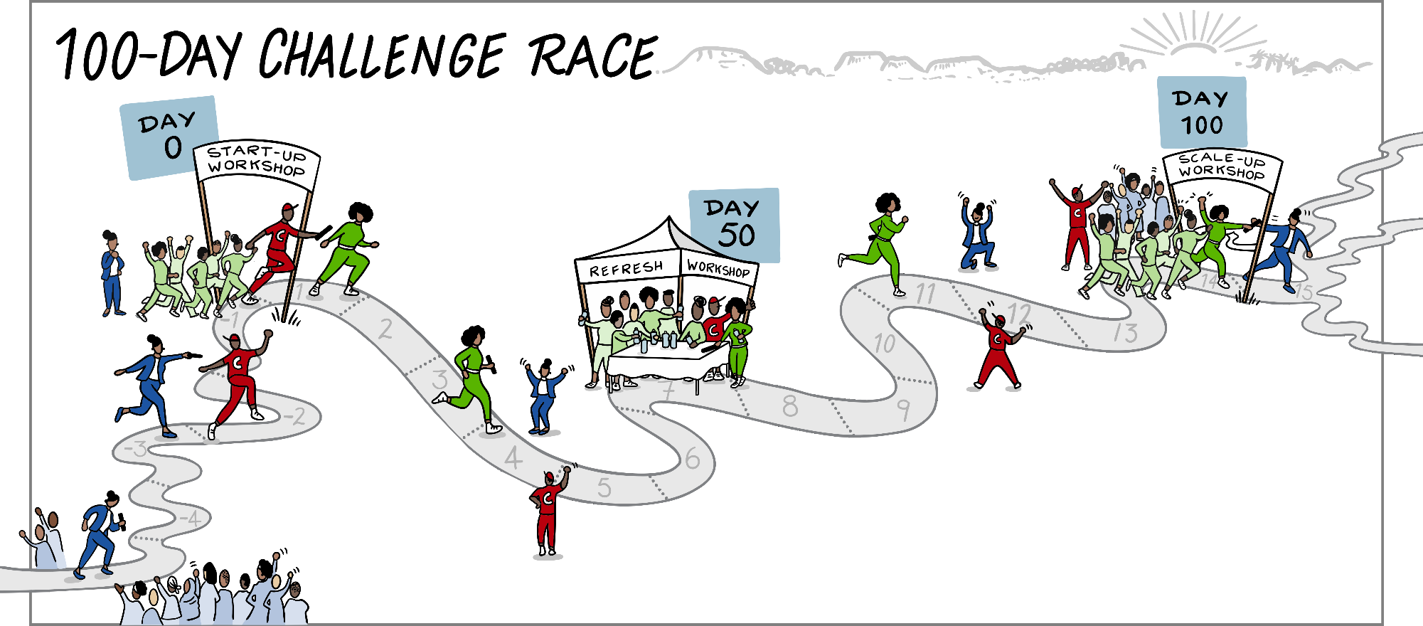
Our 100-Day Relay Race
Challenge Strategist

Slide 3
Share and celebrate
Complete the project
Objectives
Sustain the Gains
Map the Way Forward
Reflect and Close-out

Slide 4
Share & Celebrate
While the team present, those not part of the team make notes on:
Questions to ask afterwards
Team practices to try in other parts of the organisation
Suggestions for the team

Slide 5
Complete the project
Final sprint plan
(only use if team have outstanding actions, add them here)

Slide 6
Sustainability Recommendations
Final sprint plan
(Add the sustainability action recommendation the team developed in preparation for landing.)

Slide 7
Continuing the journey
Team’s idea
Add the team ideas
Follow-on 30-Day Challenge?
New focus area for 30-Day Challenge?
Multiple 30-Day Challenges as once?

Slide 8
Reflection
On your phones
In your browsers go to
www.menti.com
Add your code

Slide 9
Appreciations

Slide 10
www.endinggbvf.org

