Slide 1
Refresh Workshop
Movement

Slide 2
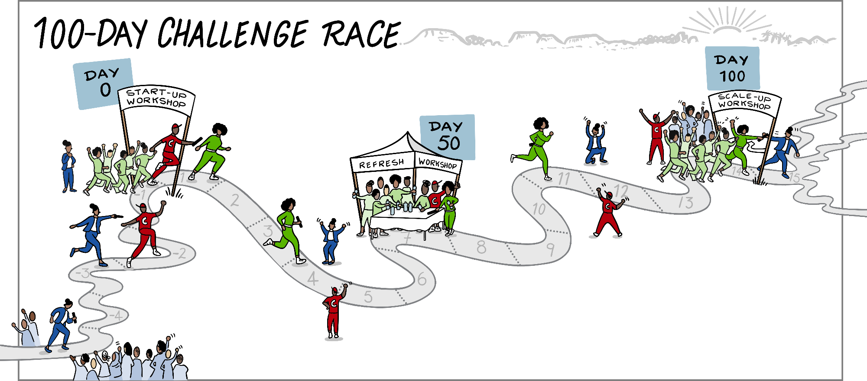
Our 100-Day Relay Race
Challenge Strategist

Slide 3
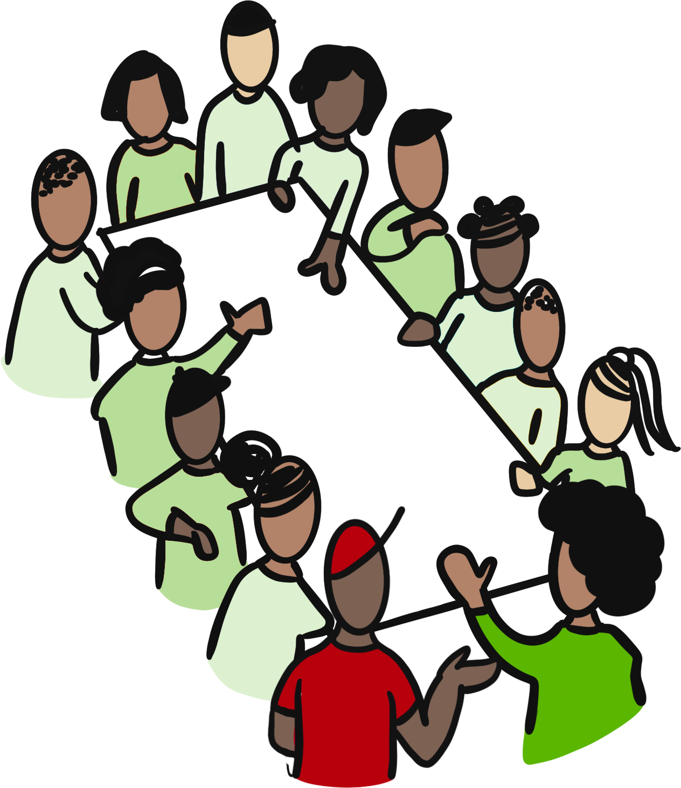
Review progress so far, and renew our commitment to the 100-day Goal.
Sharpen our plan: Identify additional actions that can help us achieve our goal
Objectives
Reflect on our Team Agreement: What are we doing well? What do we need to change?
Talk with our Leaders - about the past, the present and the future

Slide 4
Getting Started...
What was one positive surprise about working on this challenge?
What was a not so-positive experience?
What made you a little uncomfortable?

Slide 5
Goal Confidence
On a SCALE of 1-5 how confident are we that we will reach your 100-Day Goal?
1 = I feel we have no chance to reach our goal
5 = I am 100% certain we will reach our goal

Slide 6
Project progress
What are 2-3 things
the team did that
contributed the most
towards achieving the goal?

Slide 7
Overcoming Obstacles - Troika
Troika Consulting
About giving and getting help
Form groups of 3
3 Rounds
with the same 3 people
In each round
1 person is the client
the other 2 are consultants/advisors
Everyone takes a minute to think of an obstacle that your team face that you would like help on (as a ‘client’)

Slide 8
Overcoming Obstacles - Troika
The clients shares an obstacles and answer clarifying questions
The advisors share ideas/experiments they think would be helpful for the client
After each round we change
roles but stay in the same group
IDEAS for advisors
Power through this? OR
Work around it? OR...
Shift your position or the destination?

Slide 9
Overcoming Obstacles - Troika
One advisor keep an eye on the time.
We will announce
when a NEW ROUND must start.
In groups of 3 - choose someone to start as client.
1 min | Client shares an obstacle.
2 min | Advisors ask clarifying questions. No advice yet!
4 min | Client turns around facing away and advisors give ideas, suggestions and advice.
2 min | Client turns back and share their takeaways from the advice.
 | Next round - Pick the next client and repeat steps

Slide 10
Sharpening the plan
Translate the Troika advice into action steps in the work plan.
And what else can the team do in the next part of the challenge to increase the odds of achieving the goal?
Prioritise if need be, and build into the plan.

Slide 11
Reflect on the team agreement
Add the link to your Mentimeter survey here

Slide 12
Conversation with Leaders
Looking in
Looking Back
Looking forward
Revised goal, Progress and improvement ideas and New ideas
Thank you
Please help!
Advice and ideas to prepare for Sustainability & Scaling

Slide 13
www.endinggbvf.org

