Slide 1
GBVF Maturity 30-Day Challenge
Lift-off Workshop
Movement

Slide 2
GBVF Maturity Health Check focus area
Purpose
Self-assessment of how we are doing on GBVF related behaviours, policies, and practices.
Help us identify areas to improve
Not a GBVF audit
Self-improvement tool
Guide GBVF Maturity journey
Our survey gaps
xxxxxxx

Slide 3
What we doing today
What is 30-Day Challenges all about
Shaping our 30 day goal
Developing our team agreement
Developing our work plan

Slide 4
What is a 30-Day Challenge?
It is a project
It lasts 30 days
Like all projects, it has a…
A goal
A team
A plan
What makes it different?
It is designed to harness the power of crises, without creating a crisis!

Slide 5
What makes it different?
30-Day Challenge is a 100-Day Challenge on steroid….
Just simpler and faster and internally in an organisation

Slide 6
30 & 100-Day Challenge
Crisis
Sense of urgency
Fast - 30 or 100 days from project start to completion
Inspire unusual behaviours
Success, or even survival is far from guaranteed
30 or 100-Day Goal feels almost impossible to achieve
“All hands-on deck” - all focused on the crises
Right team is assembled, all committed to the goal
People ignore red tape, hierarchy and approvals
The Challenge team has full agency of their plan, to experiment and pivot during the 30 or 100 days

Slide 7
How will it work

Slide 8
Our 30-Day Challenge
Aim
Rapidly improve GBVF Maturity in our organisation focusing on a priority area as revealed by the Health Check results
Leaders
Set-up
Decisions
Leaders
Amplifier decisions
Sustain & Amplify
Set-up
30-Days implementation

Slide 9
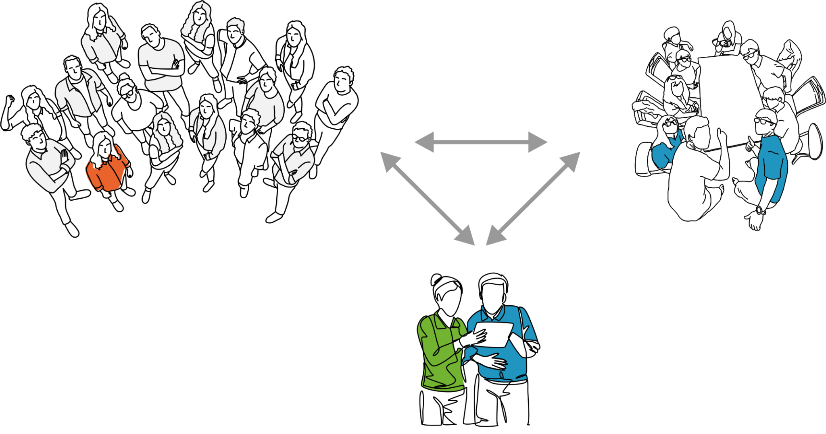
30-Day Challenge team
Leadership team
30-Day team
Context - Review Health Check Survey results
Focus – Decide on behaviour, practice, or policy to focus on
Actors - Select the 30-Day team (4-8 staff members) and Team Coach.
Goal - Set 30-Day Goal
Plan - Develop and implement the 30-day Work Plan
Team - Elect team leaders & shape team agreement
Challenge mentor
Team
leaders
Team coach
Facilitate the workshops and coach the team leader

Slide 10
Shaping our 30-Day Goal
OUTCOME - Visible & Tangible benefit to “customers”
“WOW” factor – highly visible
EASY to MEASURE – frequently and cheaply
EASY to UNDERSTAND – Grandmother understands & newspaper headline
Fully OWNED by the team
What makes a good 30 day goal?

Slide 11
SMURF not SMART Goal!
S = Strategic
M = Measurable
U = Unreasonable
R = Results-Oriented
F = Fast

Slide 12
Policy goal templates
Creating a
new policy
Disseminating an
Existing Policy
Moving from
policy to action
Within 30 days, we will develop a policy/process for __________, and we will get this approved by _____ and by the management team
Within 30 days, we will ensure that at least ____% of staff are aware of the policy about _____________. We will measure this using “yes/no” text message to all staff
During the last ___ weeks of November, ____ % of staff who report a ______ incident will receive _________ support within ____ hours, and a proper investigation will get underway within ____ hours.

Slide 13
Behaviour goal templates
Breaking
the silence
Healing
the wounds
Changing
the culture
Within 30 days, we will increase the number of staff members who file complaints (or speak up about) __________ from ___ per week to ____ per week.
During the last ___ weeks of November, ____ % of staff who report a ______ incident will receive _________ support within ____ hours, and a proper investigation will get underway within ____ hours.
The last week of November will be a “GBVF model week”, where we will have ___ incidents of ______. We will measure this through a yes/no text survey to all staff (asking if they experienced or or observed any type of ________________)

Slide 14
Refining the goal
Compared to this baseline in the GBVF Health Check survey, does the goal feel really “unreasonable”?
When will we start measuring progress towards the goal and how often will we track the progress?
Is the goal framed as “In 30 days,... OR “Within the last week of the 30 days…?” OR "During the 30 days after the Challenge..." Which framing is more suitable?
What are the possible adverse consequences of pursuing this goal? What are ways to ensure that the team mitigates these?

Slide 15
Team leader election and team agreement
Role
Helps team members stay organised and focused on the goal.
Coordinates, as needed, with the Mentor
Leads weekly team meetings
Our
Team leader
Electing our team leader
Submit 1 or 2 names (you can nominate yourself)
Let’s vote
Not necessarily the most vocal, but one who can bring team members together

Slide 16
Our team agreement
Team structure
Who will play the role of data geek and storyteller? What other roles do we need?
What name do want to call our team, if any?
Who else to invite to join the team?
Management rhythm
When and where will we have our weekly meeting?
How and who will brief new team members?
How we will work together
How will we hold each other accountable?
What will we do to make our collaboration fun and exciting?
What else?

Slide 17
Work plan
Step 1 - Generate ideas
Step 2 - Cluster similar ideas
Step 3 - Develop workstreams and action steps
Step 4 - Review and align on
timeline
Our roadmap for the
next 30 day

Slide 18
Step 1 – Generate Ideas
Conduct training on the new policy
Think about things the team can do to achieve the 30-Day goal (these could be actions, ideas, etc.)
Write one “thing’ on a post-it note.
Place the post-it randomly on the wall
Have a fun policy-quiz
Place policy posters in the workplace
Send WhatsApp alerts to staff about the policy
Note: These post-it’s are just examples
xxxxx
If all the ideas are “business as usual”.
challenge the team to come up with one or two new ideas!

Slide 19
Step 2 – Cluster Ideas
Training
Have a fun policy-quiz
Group post-its that go together
Label each cluster with a heading (e.g. Training)
Conduct training on the new policy
xxxxx
xxxxx
xxxxx
Measurement
xxxxx
xxxxx
Note: These clusters are just examples
xxxxx
Send WhatsApp alerts to staff about the policy
Place policy posters in the workplace
Awareness Building
Role Clarification

Slide 20
Step 3 – Workstreams
Team Name:
Awareness Building
Action
Action
Action
Action
Training
Action
Action
Action
Role Clarification
Action
Action
Action
Team’s
30-Day
Goal
Measurement
Action
Action
Action
Action
Workstream 5
Action
Action
Week
1
Week
2
Week
3
Week
4
Day 30

Slide 21
Step 3 – Workstreams
Place the cluster of post-its in your workstreams (you can convert some of these into action steps).
Decide what action steps need to be taken to achieve the 30-day sub-goal in your workstream
For each action step, decide on one team member to own this, and a time frame for completion (week 1, 2, 3, or 4)
Write this on a post-it note and place it in the corresponding week on the workstream swim lane
Action Step
Example
Create simplified version or infographic of the policy
Octavia (week 1)

Slide 22
Step 4 – Review and align
Review the entire picture to check for alignment and gaps
Do the timings across workstreams match up? Do we need to move the post-it’s around on the timeline?
Any gaps? Are there too many actions in one week?
Additional team members to recruit?
Other leaders to reach out to?
Communication steps to inform others?
Data we need to chase?
What else?
Designate someone from the team to transcribe the information in the swimlanes into a work plan template.

Slide 23
Step 5 – Feedback and Close-out

